Slide 1
MOTIVATION
CHAPTER 12

Slide 3
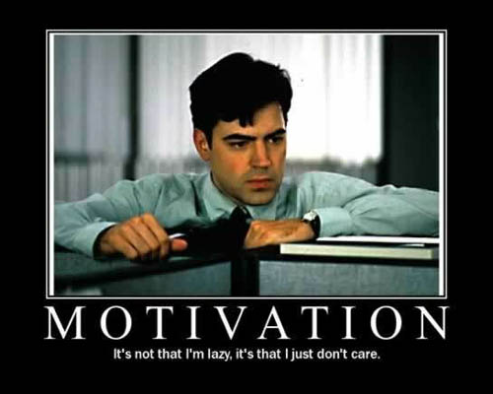

Slide 4
Drive Reduction Theory
Arousal Theory
Theories
Maslow’s Hierarchy of Needs
Human Drives
We are here
Sources
Measures
Intrinsic/
Extrinsic Motivation
Motivation & Emotion
Motivation
Stress
Coping
Explain complex motives (eating, aggression, achievement and sex)
Effects
Theories of Emotion
Opponent Process
James-Lange
Cognitive Appraisal
Cannon-Bard
Schachter two-factor

Slide 5
Motivation Theories/Perspectives
1. Instinct/Evolutionary
2. Drive Reduction
3. Optimum Arousal
4. Maslow’s Hierarchy

Slide 6
1. Instinct Perspective
Instinct Perspective: we are motivated by our inborn, automated behaviors.
INFANT Reflexes:
Rooting: Grasping:
Babinski: Moro:
Sucking:

Slide 7
Instinct →Evolutionary
Idea that instincts control behavior has been replaced by the evolutionary perspective, which searches for the adaptive functions of behavior

Slide 8
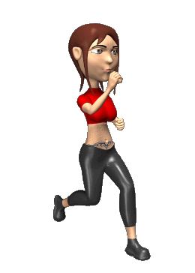
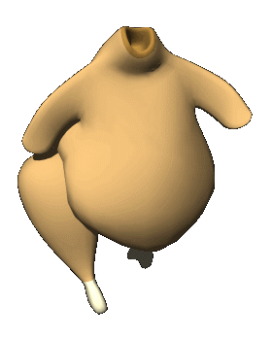
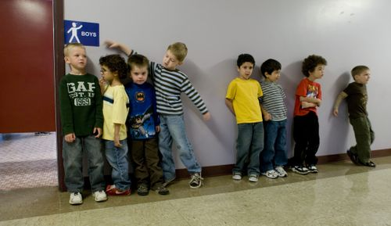
2. Drive-Reduction Perspective
Our behavior is motivated by BIOLOGICAL NEEDS.
Body wants to maintain HOMEOSTASIS.
When we are not, we have a need that creates a drive.
Primary versus Secondary drives

Slide 9
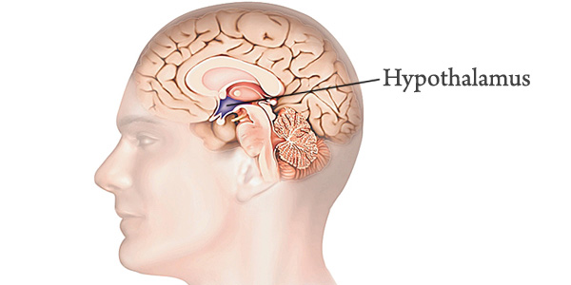
BIOLOGICAL DRIVES (Primary Drives)
Unlearned drive based on a physiological state found in all animals
Motivate behavior necessary for survival
Hypothalamus
Hunger
Thirst
Sex
Evolutionary psychology talks about the four Fs (fighting, fleeing, feeding and reproducing).

Slide 10
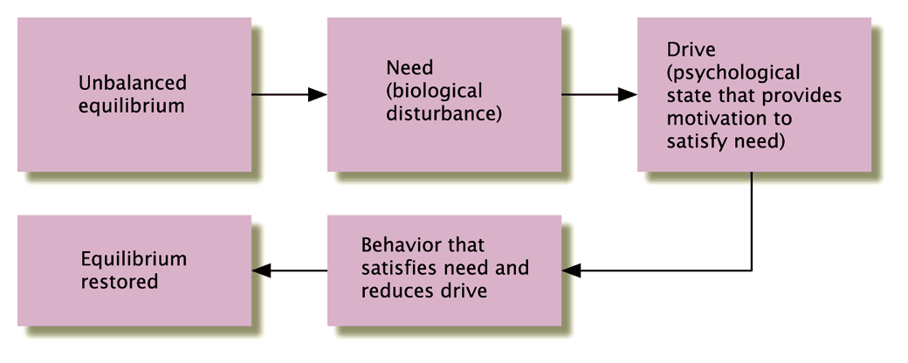

Slide 11
DRIVES AND INCENTIVES
Tension
Notes:
We are pushed by our “need” to reduce drives and pulled by incentives—either positive or negative stimuli that lure or repel us
Aroma of a good home cooked meal (Thankgiving)
When there is both a need and incentive, we are strongly driven
Similar to Skinner’s concept of reinforcement/punishment—we are encouraging behavior (reinforcement) and discouraged from doing a behavior (punishment)

Slide 12
DRIVES AND INCENTIVES
Notes:
Psychological aim of drive reduction is homeostasis: Maintenance of steady internal state

Slide 13
DRIVE REDUCTION
The physiological aim of drive reduction is homeostasis, the maintenance of a steady internal state – balance. The regulation of any aspect of body chemistry around a particular level
Drive
Reduction
Food
Empty Stomach
(Food Deprived)
Stomach Full
Organism

Slide 14
Drive Reduction Theory
We are pushed by internal drives & pulled by external incentives.

Slide 15
DRIVE REDUCTION THEORY
Strengths
Does a nice job explaining most primary drives
Weaknesses
Falls apart with more complex behaviors/secondary drives

Slide 16
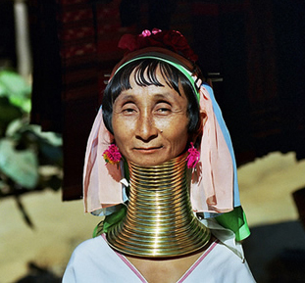
Drive reduction doesn’t explain…

Slide 17
Drive reduction doesn’t explain…

Slide 18
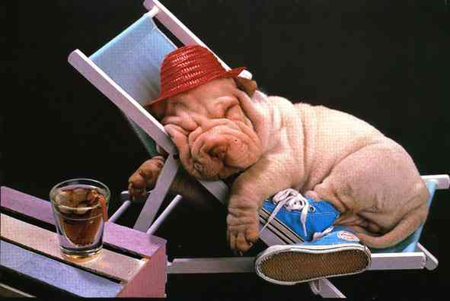
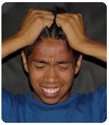
3. Arousal Perspective
We are motivated to seek an optimum level of arousal.

Slide 19
AROUSAL THEORY
People do things in order to seek out an optimal level of arousal for a given moment
I want a high level or arousal – let’s do something epic tonight.
I want a low level of arousal – let’s stay in tonight.
I am bored with my life I need a new job.
I am stressed at work, let’s take a vacation.
Notes:
Human motivation aims not to eliminate arousal but to seek optimum levels of arousal.
Too much arousal=stress
Optimum Arousal
Monkeys who investigate how to open a window, toddler who is investigative and gets into everything in the house
Those who enjoy high arousal are most likely to enjoy intense music, food, and risky behaviors
Human motivation aims not to eliminate arousal, but to seek optimum levels of arousal

Slide 20
YERKES-DODSON LAW
States that there is an optimal level of arousal for best performance on any task
The more complex the task, the lower the level of arousal that can be tolerated without interfering with performance

Slide 21
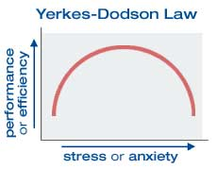

Slide 23
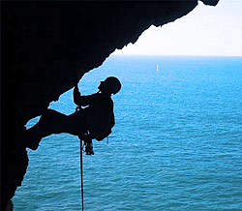

Slide 25
Abraham Maslow

Slide 26
4. Maslow’s Hierarchy of Needs
Abraham Maslow said we are motivated by needs, and all needs are not created equal.
We are driven to satisfy the lower level needs first.

Slide 27
Criticisms of Maslow’s Hierarchy
Seen as far too simplistic.
Does not predict or explain.
People may not have to satisfy one kind of need before addressing another.
The needs that are most important to people’s satisfaction with life do not always correspond to Maslow’s hierarchy.
Ordering of needs varies among cultures.

