Slide 1
HUNGER MOTIVATION

Slide 2
Drive Reduction Theory
Arousal Theory
Maslow’s Hierarchy of Needs
Theories
Human Drives
Sources
Measures
Instinct
>>Evo.
Motivation & Emotion
Motivation
Stress/Health
We are here
Effects
Coping
Explain complex motives (eating, achievement and sex)
Theories of Emotion
Opponent Process
James-Lange
Cognitive Appraisal
Cannon-Bard
Schachter two-factor

Slide 3
Hunger
Physiological
Psychological

Slide 4
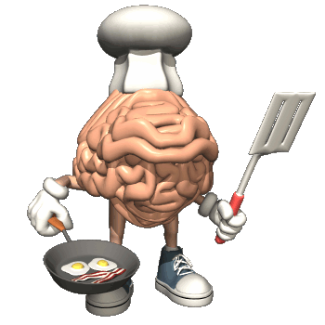
What Is Hunger?
Hunger is the general state of wanting to eat.
Satiety is the general state of no longer wanting to eat.

Slide 5
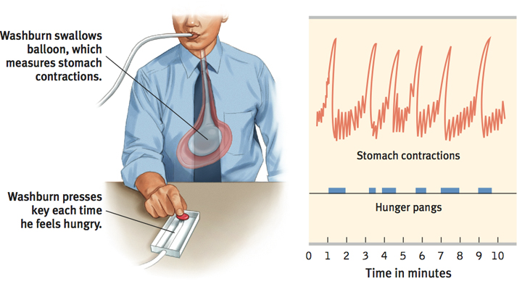
THE PHYSIOLOGY OF HUNGER
Contractions of the stomach
Washburn study
Notes:
Body Chemistry and the Brain
People/animals automatically regulate their caloric intake to prevent energy deficits and maintain a stable body weight
One resource = glucose—blood sugar
Increases in the hormone insulin (secreted by the pancreas) diminishes blood glucose by converting it to stored fat. If your blood glucose level drops, you won’t consciously feel this change. But your brain—which automatically recognizes this, will trigger hunger
Signals from your stomach, intestines and live all signal your brain to motivate you to eat or not

Slide 6
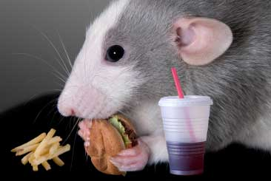
STOMACHS REMOVED
Tsang (1938) removed rat stomachs, connected the esophagus to the small intestines, and the rats still felt hungry (and ate food).

Slide 7
GLUCOSE: C₆H₁₂O₆
The glucose level in blood is maintained by your pancreas. Insulin decreases glucose in the blood, when the level gets too low, we feel hungry.
Glucose Molecule
Notes:
One resource = glucose—blood sugar
Increases in the hormone insulin (secreted by the pancreas) diminishes blood glucose by converting it to stored fat. If your blood glucose level drops, you won’t consciously feel this change. But your brain—which automatically recognizes this, will trigger hunger
Signals from your stomach, intestines and live all signal your brain to motivate you to eat or not

Slide 8
GLUCOSE & THE BRAIN
Levels of glucose in the blood are monitored by receptors (neurons) in the stomach, liver, and intestines. They send signals to the hypothalamus in the brain.
Rat Hypothalamus

Slide 9
The Brain
In the 1960’s it was discovered that hunger comes from………..
The Hypothalamus
Notes:
In addition to hunger it also satisfies the 4 Fs

Slide 10
Glucose & the Brain
Ventromedial Hypothalamus
Rat Hypothalamus
Lateral Hypothalamus

Slide 11
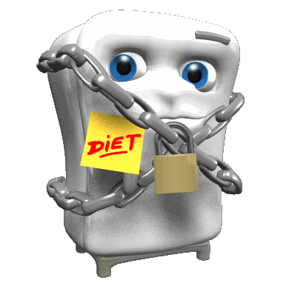
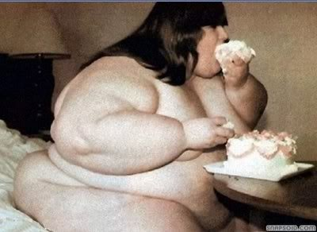
Hypothalamus
Lateral Hypothalamus
Ventromedial Hypothalamus
When stimulated it makes you hungry.
When lesioned (destroyed) you will never be hungry again.
When stimulated you feel full.
When lesioned you will never feel full again.
Notes:
LATERAL… “LATE…” It is late… TIME TO EAT

Slide 12
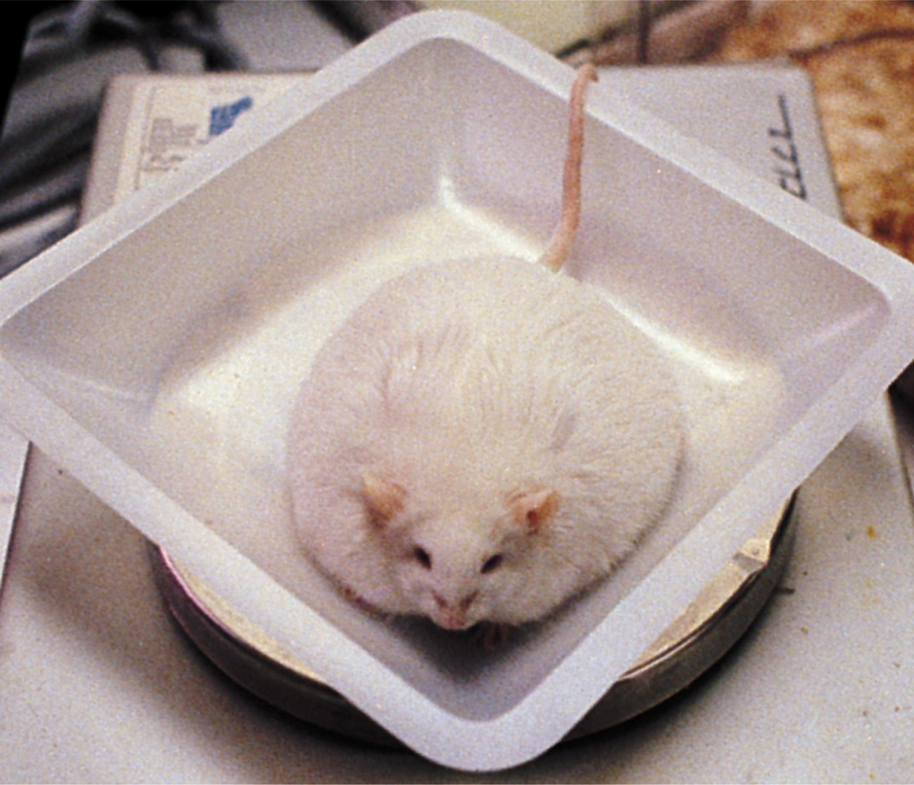

Slide 13
400% wt increase!!

Slide 14
Hypothalamus
2 Sections
2 Theories
Lat.
Leptin
Ventro.
Set-Point

Slide 15
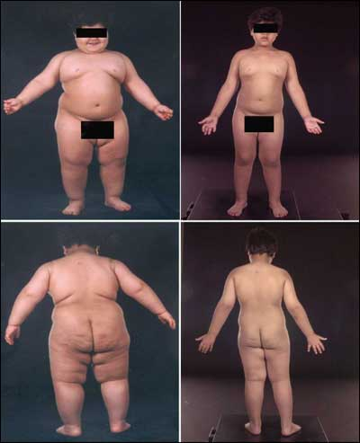
How does the hypothalamus work?
1. Leptin Theory
Leptin is a protein produced by bloated fat cells.
Hypothalamus senses rises in Leptin and will curb eating and increase activity.
Can Leptin injections help me?
Notes:
High levels of leptin signal the brain to reduce appetite or increase the rate at which fat is burned.
Leptin deficiency can cause obesity

Slide 16
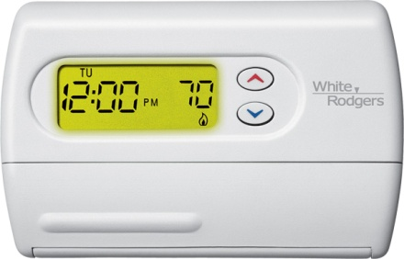
2. Set-Point Theory
According to the set-point theory, there is a control system built into every person dictating how much fat he or she should carry – a kind of thermostat for body fat.
According to this theory, body fat percentage and bodyweight are matters of internal controls.
Notes:
Some individuals have high, some have low. Relates to your metabolism. High v. Low.

Slide 17
Set Point Theory
Set point could be related to genetic disposition
Set point could be related to chronic feeding in infancy
NOT ALL PSYCHOLOGISTS believe in set point theory…
Notes:
The critics say it is too simplistic. some say weight control is more about learning and cognition than with the hypothalamus

Slide 18
How to change the set point
Dieting does nothing (by dieting, I mean calorie-cutting)
Long-term caloric deprivation, in a way that is not clear, acts as a signal for the body to turn down its metabolic rate.
A plateau is reached at which further weight loss seems all but impossible.
Notes:
The body reacts to stringent dieting as though famine has set in. Within a day or two after semi-starvation begins, the metabolic machinery shifts to a cautious regimen designed to conserve the calories it already has on board. Because of this innate biological response, dieting becomes progressively less effective. When the set point is driven too low, depression and lethargy may set in as a way of slowing the person down and reducing the number of calories expended.

Slide 19
How to change the set point
So far no one knows for sure how to change the set point, but some theories exist.
regular exercise is the most promising as a sustained increase in physical activity seems to lower the setting (doesn’t just resist it like dieting does)

Slide 20
The Psychology of Hunger
Environmental cues can trigger the biological responses (increased insulin production)
Memory plays an important role in hunger. Due to difficulties with retention, amnesia patients eat frequently if given food (Rodin et al., 1998).
Emotional Cravings
Culture
Conditioning (Taste Aversions)

Slide 21
Taste Preferences
Food tastes better and we chew less when we are hungry (beginning of a meal).
Food tastes worse and we chew more when we are not hungry (at the end of the meal).
Its weird, the better the food tastes, the less time we leave it in our mouths.

Slide 22
Taste Preference: Biology or Culture?
Body chemistry and environmental factors influence not only how much or when we feel hunger but what we feel hungry for!
Richard Olsenius/ Black Star
Victor Englebert

Slide 23
Hot Cultures like Hot Spices
Countries with hot climates use more bacteria-inhibiting spices in meat dishes.

Slide 24
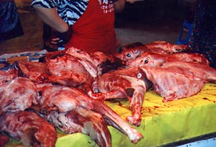
Dog
Mice Wine
Fried Frog Legs
Criadillas- bull testicles.

Slide 25
Hunger
Physiological
Psychological

Slide 28
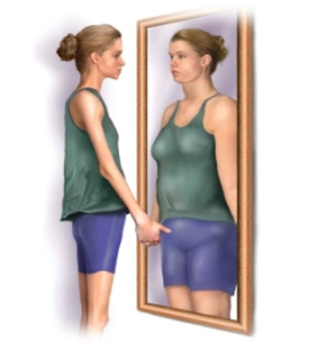
Eating Disorders
Anorexia Nervosa
An eating disorder characterized by being obsessed with losing weight. Typically drop significantly below normal weight, yet feel fat and continue to limit food intake.

Slide 29
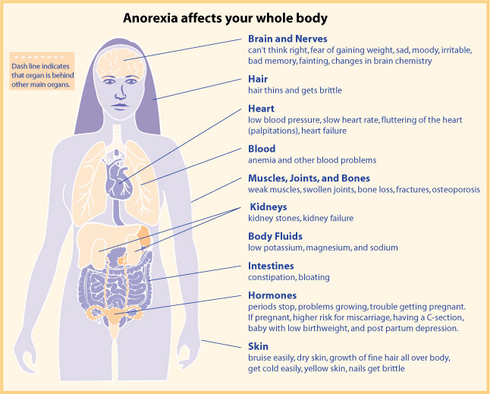
Notes:
Anorexia nervosa—an eating disorder in which individuals drop significantly (15% or more) below normal weight
Often begins as a weight-loss diet
Remain obsessed with losing weight
Usually occurs in adolescents and females (3 out of 4)
½ of those with anorexia display a binge-purge-depression cycle

Slide 30
DSM-V Criteria for Anorexia Nervosa
Refusal to maintain body weight at or above a minimally normal weight for age and height (eg, weight loss leading to maintenance of body weight less than 85% of that expected or failure to make expected weight gain during period of growth, leading to body weight less than 85% of that expected).
Intense fear of gaining weight or becoming fat, even though underweight.
Disturbance in the way in which one's body weight or shape is experienced, undue influence of body weight or shape on self-evaluation, or denial of the seriousness of the current low body weight.
In postmenarchal females, amenorrhea ie, the absence of at least three consecutive cycles. (A woman is considered to have amenorrhea if her periods occur only following hormone, eg, estrogen administration.)

Slide 31
Eating Disorders
Bulimia Nervosa
An eating disorder characterized by episodes of overeating, usually of high caloric foods, followed by vomiting, laxative use, fasting, or excessive exercise.

Slide 32
DSM-V Criteria for Bulimia Nervosa
Recurrent episodes of binge eating. An episode of binge eating is characterized by both of the following:(1) Eating, in a discrete period of time (eg, within any 2-hour period), an amount of food that is definitely larger than most people would eat during a similar period of time and under similar circumstances.(2) A sense of lack of control over eating during the episode (eg, a feeling that one cannot stop eating or control what or how much one is eating).
Recurrent inappropriate compensatory behavior in order to prevent weight gain, such as self-induced vomiting; misuse of laxatives, diuretics, enemas or other medications; fasting or excessive exercise.
The binge eating and inappropriate compensatory behaviors both occur, on average, at least twice a week for 3 months.
Self-evaluation is unduly influenced by body shape and weight.
The disturbance does not occur exclusively during episodes of anorexia nervosa.
Specify type:
Purging type: During the current episode of bulimia nervosa, the person has regularly engaged in self-induced vomiting or the misuse of laxatives, diuretics or enemas.
Nonpurging type: During the current episode of bulimia nervosa, the person has used inappropriate compensatory behaviors, such as fasting or excessive exercise, but has not regularly engaged in self-induced vomiting or the misuse of laxatives, diuretics or enemas.

Slide 33
Reasons for Eating Disorders
Sexual Abuse: Childhood sexual abuse does not cause eating disorders.
Family: Younger generations develop eating disorders when raised in families in which weight is an excessive concern.
Genetics: Twin studies show that eating disorders are more likely to occur in identical twins rather than fraternal twins.
Obsessive-compulsive disorder – need to control
Depression and low-self esteem

Slide 34
DSM Factors
High levels of hostility, chaos, and isolation and low levels of nurturance and empathy are reported in families of children presenting with eating disorders.
Anorexia has been formulated as a reaction to demands on adolescents to behave more independently or to respond to societal pressures to be slender.
AN patients are usually high achievers. Many experience their bodies to be under the control of their parents.
Self-starvation may be an effort to gain validation as a unique individual.
Patients with BN have been described as having difficulties with impulse regulation.

Slide 35
Prevalence
Eating disorders have been reported in up to 4% of adolescents and young adults.
Up to 50% of patients with AN develop bulimic symptoms, and some patients who are initially bulimic develop anorexic symptoms
The most common age of onset for AN is the midteens although in 5% of the patients, the onset of the disorder is in the early twenties. The onset of BN is usually in adolescence but may be as late as early adulthood.

Slide 36
Both AN and BN are more commonly seen in females with estimates of male-to-female ratio ranging from 1:6 to 1:10

Slide 37
Summary

