Slide 1
EXPRESSED EMOTION

Slide 2
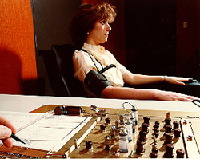
Emotion- Lie Detectors
Polygraph
machine commonly used in attempts to detect lies
measures several of the physiological responses accompanying emotion
perspiration
heart rate
blood pressure
breathing changes

Slide 3
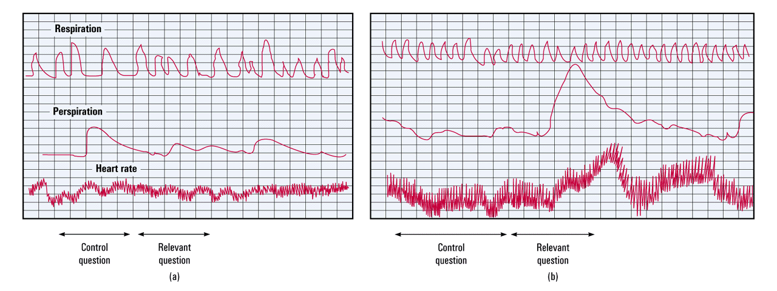
Respiration
Perspiration
Heart rate
Control
question
Relevant
question
Control
question
Relevant
question
(a)
(b)

Slide 4
Emotion- Lie Detectors
Percentage
50 Innocents
50 Theives
1/3 of innocent declared guilty
1/4 of guilty declared innocent (from Kleinmuntz & Szucko, 1984)
80
70
60
50
40
30
20
10
0
Innocent
people
Guilty
people
Judged innocent by polygraph
Judged guilty by polygraph

Slide 6
GENDER, EMOTION AND NONVERBAL BEHAVIOR
Women are much better at discerning nonverbal emotions than men. When shown sad, happy, and scary film clips women expressed more emotions than men.
Notes:
OBJECTIVE 9| Describe some gender differences in perceiving and communicating emotions.
Gender, Emotion and Nonverbal Behavior
When given small hints of physical/nonverbal cues detecting harm or fear, women tend to surpass men at reading people’s emotional cues
Women tend to show more emotion when watching a scary, funny or sad film
Also women have an edge in spotting lies, and detecting a true, romantic couple relationship than a phony one
ASK—how might you feel when you say goodbye to fellow classmates after graduation who you most likely will not see much anymore?
Males tend to have simple responses (I’ll feel bad)
Females express more complex emotions (It will be bittersweet; I’ll feel both happy and sad)
Females are more emotional responsive in both positive and negative situations (more open to feelings)
Anger strikes most people as a more masculine emotion—people are quicker to see anger on men’s faces
Women are more likely than men to be empathetic (identify with others and can understand what it is like in other’s shoes)
Also more inclined to express empathy (cry when others are crying)
Mirror neurons comprise neural systems that activate when we are imagining what other people are feeling or doing. Some researchers think that mirror neurons are the physiological mechanism of empathy

Slide 7
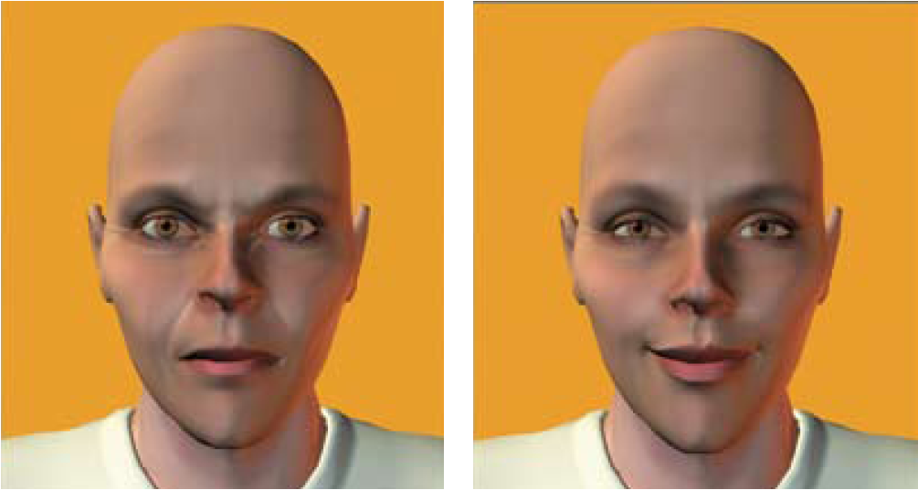
GENDER, EMOTION, AND NON VERBAL BEHAVIOR
Notes:
If a gender neutral face is made to look angry, most people will identify it as male, if made to smile, most will identify as female
**women have greater emotional literacy**

Slide 8
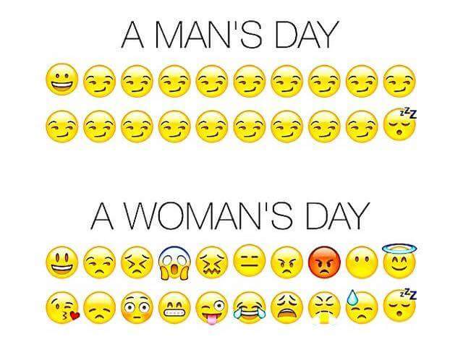
GENDER, EMOTION, AND NONVERBAL BEHAVIOR
Women are more emotionally responsive in both positive and negative situations (more open to feelings)
Women more likely than men to be empathetic
Notes:
Gender, Emotion and Nonverbal Behavior
When given small hints of physical/nonverbal cues detecting harm or fear, women tend to surpass men at reading people’s emotional cues
Women tend to show more emotion when watching a scary, funny or sad film
Also women have an edge in spotting lies, and detecting a true, romantic couple relationship than a phony one
ASK—how might you feel when you say goodbye to fellow classmates after graduation who you most likely will not see much anymore?
Males tend to have simple responses (I’ll feel bad)
Females express more complex emotions (It will be bittersweet; I’ll feel both happy and sad)
Females are more emotional responsive in both positive and negative situations (more open to feelings)
Anger strikes most people as a more masculine emotion—people are quicker to see anger on men’s faces
Women are more likely than men to be empathetic (identify with others and can understand what it is like in other’s shoes)
Also more inclined to express empathy (cry when others are crying)
Mirror neurons comprise neural systems that activate when we are imagining what other people are feeling or doing. Some researchers think that mirror neurons are the physiological mechanism of empathy

Slide 9
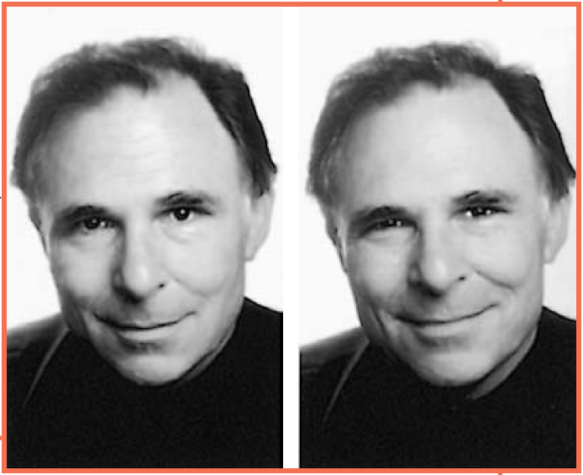
DETECTING EMOTION
Which smile is “genuine”?
Notes:
Detecting Emotion
Different cultures communicate verbally and nonverbally with different meanings
A firm handshake may signal dominance/control or an outgoing personality
Our bodies are able to detect nonverbal cues of anger, threats, happiness, etc…
**DEMO: Have students pretend to draw a capital E on their forehand using your dominant hand. What direction does the E face? If it is orientated so that someone looking at the student would have seen it in the correct position, it is likely that the student high in public self-awareness and are sensitive to social rejection. People who draw an E the correct way are likely to draw from an internal perspective and are less likely to express their true emotions.
Experience can sensitize us to particular emotions
Physically abused children will view a series of fear/angry faces with angry more than those who are not abused
Hard to control facial muscles reveal signs of emotion you would otherwise be hoping to conceal
Raising the inner part of your eyebrow reveals distress or worry
Eyebrows raised and pulled together signal fear
A feigned smile (fake smile) can continue for more than 4-5 seconds and are switched on and off more abruptly than a genuine, happy smile
Difficult to detect deceiving expressions
Only about 54% accuracy rate of detecting lies in 206 studies (difficult to tell)
People believe one sign of lying is averting (turn away) one’s gaze
Introverts do well at reading others’ emotions whereas extroverts are generally easier to read
Electronic communication use emoticons ( ☺) to express expressions behind the screen. Can’t read nonverbal physical cues –judged solely by your words
Can misread texts or emails—you may think you are just kidding with your words, but others can read it differently and offensively

Slide 10
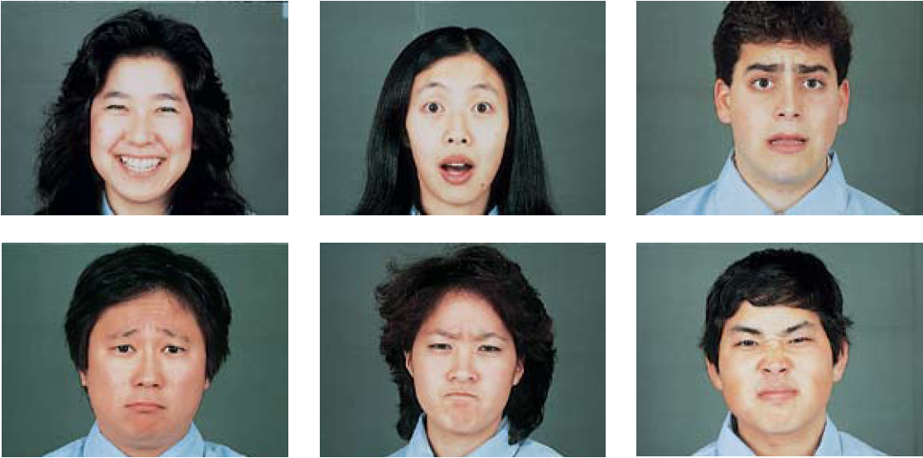
CULTURE AND EMOTIONAL EXPRESSION
Notes:
Culture and Emotional Expression
Are there acceptable gender “rules” for emotional expression?
Two men kissing each other in greeting
Two women patting each other on the behind during a sport’s competition
Men crying at a sad movie
Women violently expressing anger
Men hugging to celebrate an occasion
These are acceptable “rules” within our culture for expression emotions for each other
The meaning of gestures varies in each culture
Chinese clap their hands to show disappointment
We give the thumbs up sign when things are good, but it is taken offensively in other cultures
Do facial expressions also have different meanings in different cultures?
Paul Ekman, Wallace Friesen and other showed photographs of various facial expressions to people in different parts of the world and asked them to guess the emotion (video—History of nonverbal expression)
They also asked people in New Guinea to display various emotions in response to statements like “Pretend your child had died”. When the researchers videotaped their responses and showed them to North American college students, they were able to identify them fairly easily.
Conclusions: Regardless of cultural background, a smile is a smile around the world and similar for other facial expressions
However some cultures differ in how much emotion they express
Cultures which strive for individuality (US) display more visible emotions
Other cultures which encourages people to conform to society are less visibly displayed = collectivist cultures which conform to group standards (Asian)
Even blind children from birth exhibit the common facial expressions associated with emotions like joy, sadness, fear and anger (genetically predisposed)
Charles Darwin speculated that even in prehistoric times, before our ancestors communicated words, their ability to convey threats, greetings and submission with facial expressions helped them survive
That shared heritage, he believed, is why all human express the basic emotions with similar facial expressions
It has been adaptive for us to interpret faces in particular contexts
Movie directors create contexts and soundtracks that amplify our perceptions of particular emotions

Slide 11
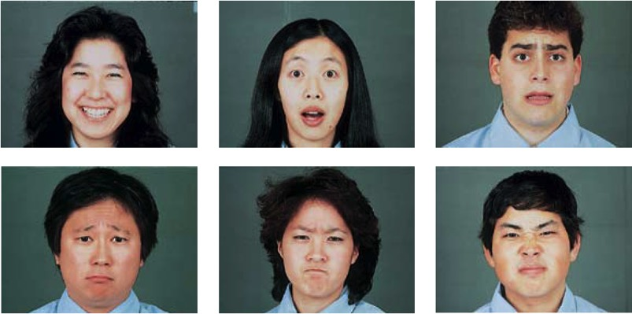
CULTURE AND EMOTIONAL EXPRESSION
Facial expressions are innate
Basic expressions are universally recognized by all cultures
Blind people exhibit same basic facial expressions
Notes:
Culture and Emotional Expression
Are there acceptable gender “rules” for emotional expression?
Two men kissing each other in greeting
Two women patting each other on the behind during a sport’s competition
Men crying at a sad movie
Women violently expressing anger
Men hugging to celebrate an occasion
These are acceptable “rules” within our culture for expression emotions for each other
The meaning of gestures varies in each culture
Chinese clap their hands to show disappointment
We give the thumbs up sign when things are good, but it is taken offensively in other cultures
Do facial expressions also have different meanings in different cultures?
Paul Ekman, Wallace Friesen and other showed photographs of various facial expressions to people in different parts of the world and asked them to guess the emotion (video—History of nonverbal expression)
They also asked people in New Guinea to display various emotions in response to statements like “Pretend your child had died”. When the researchers videotaped their responses and showed them to North American college students, they were able to identify them fairly easily.
Conclusions: Regardless of cultural background, a smile is a smile around the world and similar for other facial expressions
However some cultures differ in how much emotion they express
Cultures which strive for individuality (US) display more visible emotions
Other cultures which encourages people to conform to society are less visibly displayed = collectivist cultures which conform to group standards (Asian)
Even blind children from birth exhibit the common facial expressions associated with emotions like joy, sadness, fear and anger (genetically predisposed)
Charles Darwin speculated that even in prehistoric times, before our ancestors communicated words, their ability to convey threats, greetings and submission with facial expressions helped them survive
That shared heritage, he believed, is why all human express the basic emotions with similar facial expressions
It has been adaptive for us to interpret faces in particular contexts
Movie directors create contexts and soundtracks that amplify our perceptions of particular emotions

Slide 12
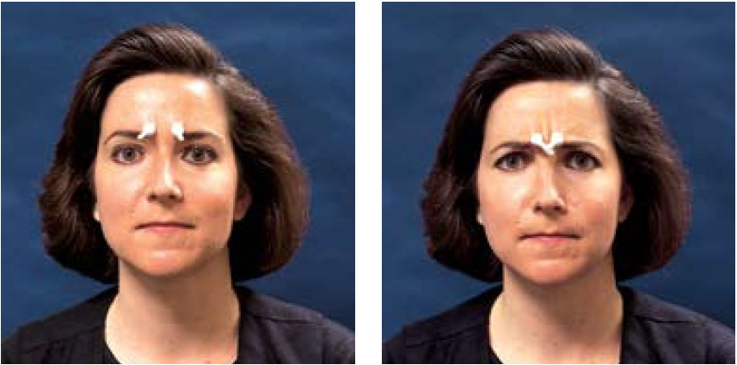
THE EFFECTS OF FACIAL EXPRESSIONS
Facial feedback
https://www.youtube.com/watch?time_continue=65&v=MtV5kfH4lXs
https://www.ted.com/talks/ron_gutman_the_hidden_power_of_smiling/transcript?language=en#t-123271
Notes:
Effects of Facial Expressions---John Cleese—The Human Face video
Expressions not only communicate emotion, they also amplify and regulate it and feed our feelings
DEMO: Place your pointer fingers on the inner part of your eyebrow. Now fake a big grin. Now scowl. Can you feel the “smile therapy” difference in your facial muscles?
In the absence of competing emotions, the facial feedback effect on experienced emotional expressions states that when a facial expression of anger or happiness intensifies feelings of anger or happiness continues and increases
A heartier smile with raised cheeks and a crinkle in the eye enhances positive feelings even more when you are reacting to something pleasant or funny
Walking with your shoulders back and your head upright (instead of down) will increase your step and encourage a mood shift

Slide 13
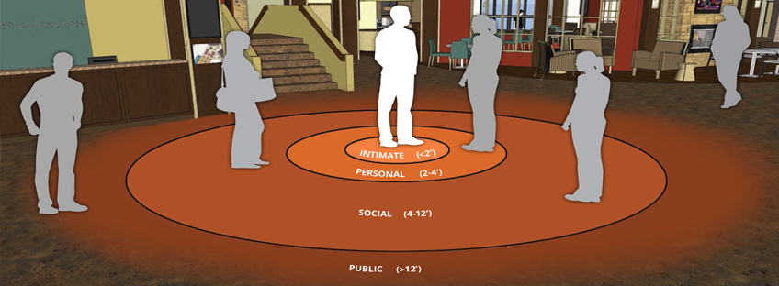
PROXEMICS

Slide 14
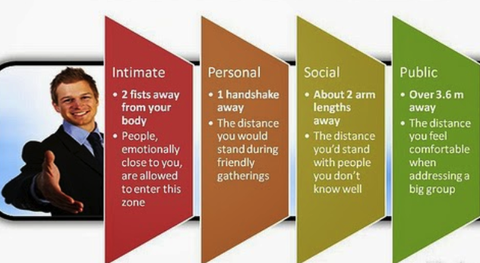
PROXEMICS

Slide 15
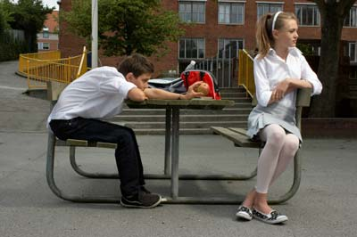
UNCOMFORTABLE
Which direction are the feet pointing?
Arms or legs crossed / hands clasped
Looking around the room
Agrees as much as possible

Slide 16
BOREDOM
Fidgeting shows boredom and restlessness.
Tapping of the foot is distracting and a sure sign of boredom.
Slow looks around the room/ceiling or a fixed gaze
Notes:
A bored facial expression is shown by half-open eyelids, just like the face of a tired person. The difference is raised eyebrows, which show a feeling of dissatisfaction or a lack of excitement

Slide 17
FLIRTING

Slide 18
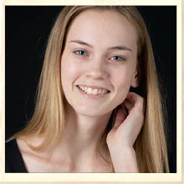
WOMEN
Primping
Eyes turned downward
Held tilting
Exposure of the neck
Smile (coy)” an expression combining a half-smile and lowered eyes”

Slide 19
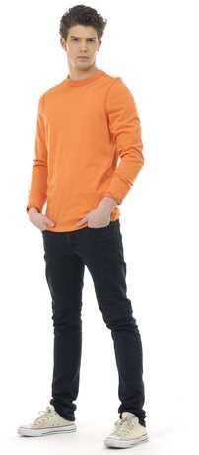
MEN
Eye contact
Proximity
Caressing of self
Needless touch
Parading
Samson pose

Slide 20
BODY LANGUAGE
Have you ever seen this?
Samson Pose

Slide 21
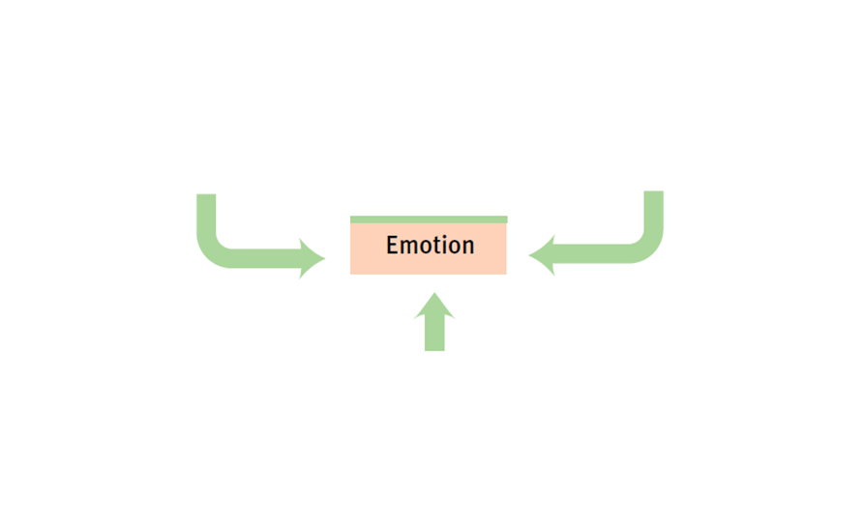
LEVELS OF ANALYSIS FOR THE STUDY OF EMOTION
Notes:
Analyzing Emotion
Emotions rely heavily on the interplay of biological, psychological and social-cultural determinants.

Slide 22
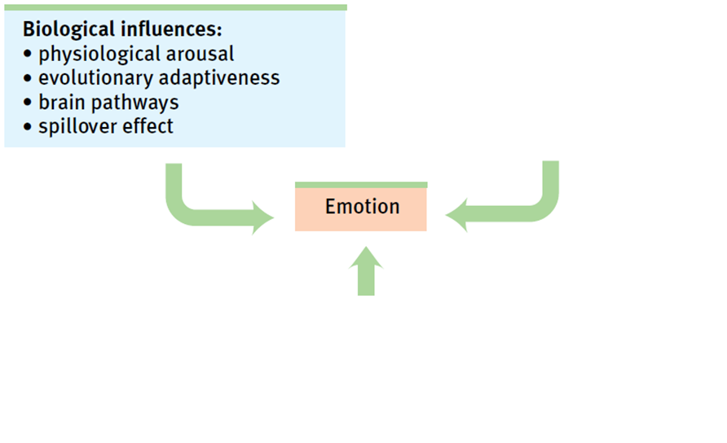
LEVELS OF ANALYSIS FOR THE STUDY OF EMOTION
Notes:
Analyzing Emotion
Emotions rely heavily on the interplay of biological, psychological and social-cultural determinants.

Slide 23
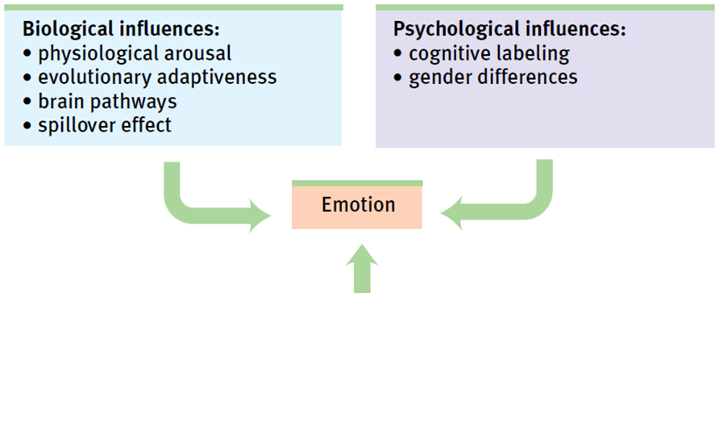
LEVELS OF ANALYSIS FOR THE STUDY OF EMOTION
Notes:
Analyzing Emotion
Emotions rely heavily on the interplay of biological, psychological and social-cultural determinants.

Slide 24
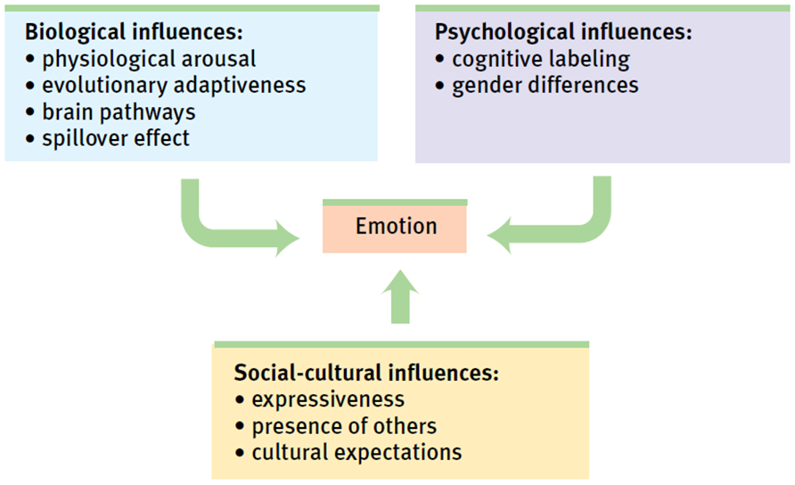
LEVELS OF ANALYSIS FOR THE STUDY OF EMOTION
Notes:
Analyzing Emotion
Emotions rely heavily on the interplay of biological, psychological and social-cultural determinants.

Slide 25
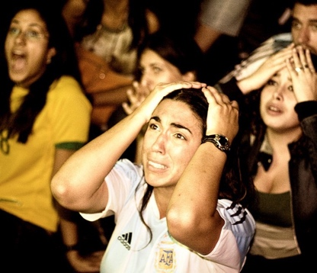
EXPERIENCED EMOTION

Slide 26
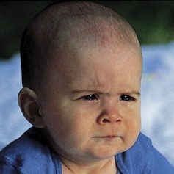
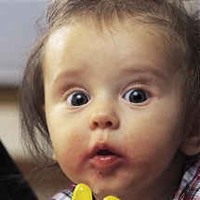
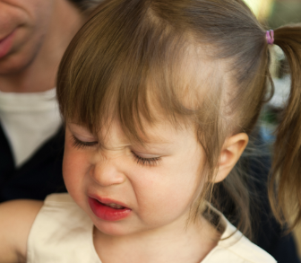
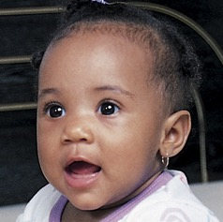
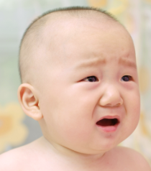
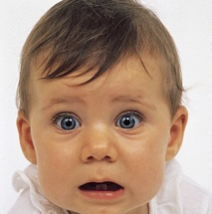
(a) Joy (mouth forming smile, cheeks lifted, twinkle in eye)
(b) Anger (brows drawn together and downward, eyes fixed, mouth squarish)
(c) Interest (brows raised or knitted, mouth softly rounded,
lips may be pursed)
(d) Disgust (nose wrinkled, upper lip raised, tongue pushed outward)
(e) Surprise (brows raised, eyes widened, mouth rounded in oval shape)
(f) Sadness (brow’s inner corners raised, moth corners drawn down)
(g) Fear (brows level, drawn in and up, eyelids lifted, mouth corners retracted)
Figure 8B.15 Infants’ naturally occurring emotions To identify the emotions present from birth, Carroll Izard analyzed the facial expressions of infants.
© 2011 by Worth Publishers

Slide 27
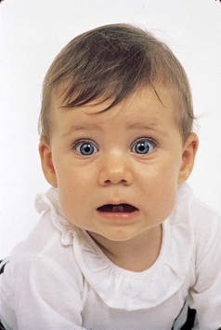
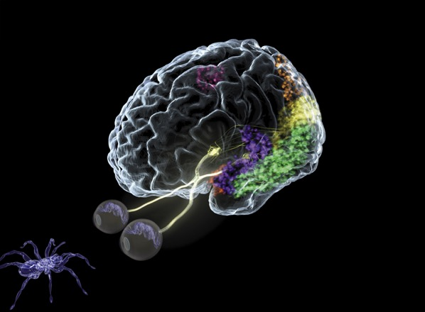
FEAR
Adaptive value of fear
The biology of fear
amygdala
https://www.youtube.com/watch?v=agi4geKb8v8
Notes:
Fear
Fear can be poisonous. It can torment us, rob us of sleep and preoccupy our thinking
Fear can be contagious
Fear is adaptive (it’s an alarm system which prepares our bodies to flee from danger)
Learning fear
The “politics of fear” build upon people’s fear (of terrorists, immigrants, criminals)
Through conditioning a short list of naturally painful and frightening events can multiple into a long list of human fears (fear of failure/success, fear of another race/nation, etc…)
A learned fear (by observing others) is remembered and persists even months later
Biology of Fear
One key to fear learning lies in the amygdala—associates fear with certain situations
Some people with phobias have intense fears of specific objects or situations that disrupt their ability to cope
Experience and our genes helps to shape our fearlessness or fearfulness
Scientists have isolated a gene that influences the amygdala’s response to frightening situations. People with a short version of this gene have less of a protein that speeds the reuptake of the neurotransmitter serotonin

Slide 28
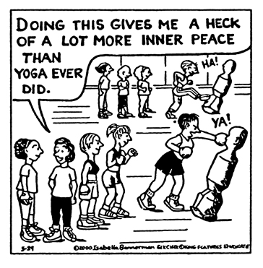
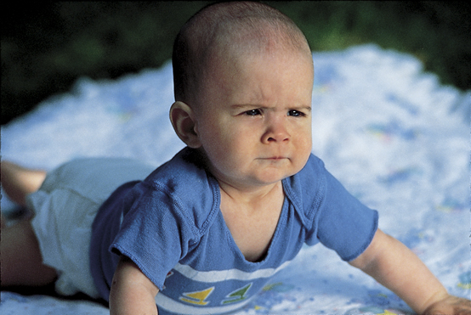
ANGER
Anger
Evoked by events
Catharsis
Expressing anger can increase anger
Notes:
Anger
Anger is a short madness that carries the mind away and can be many times more hurtful than the injury that caused it
Sometimes anger is a response to a friend or loved ones harmful mistakes or words
Simple acts like a dead cell phone, traffic jam, aches and pains can cause anger
Chronic hostility is linked to heart disease
How do we respond to anger?
Boys: walk it off or work it off at the gym
Girls: talking with a friend, listening to music or writing
Releasing hostile feelings in a healthy way instead of internalizing them can better for the body and mind→primarily a suggestion for Western cultures where individuals can express themselves more
By doing so, we can experience an emotional release (catharsis). The catharsis hypothesis maintains that “releasing” aggressive energy (through action or fantasy) relieves aggressive urges
A cooling-off period, along with engaging in behaviors that promote positive emotions will help people feel less angry in the long run
Expressing anger can be temporarily calming if it does not leave us feeling guilty or anxious
Sometimes expressing anger can lead to more anger and exhibit more hostility than a person had been feeling prior to releasing anger
Brad Bushman (2002): “Venting to reduce anger is like using gasoline to put out a fire”
Anger primes prejudice
After 9/11, Americans who responded with anger more than fear displayed intolerance for immigrants and Muslims
Best way to handle our anger?
1. Wait (cooling off period)
2. Deal with anger in a way that involves neither being chronically angry over every little annoyance, nor sulking and rehearsing your grievances
Exercising, playing an instrument, talking with a friend
Civility means not only keeping silent about trivial (minor) irritations but also communicating important ones clearly and assertively

Slide 29
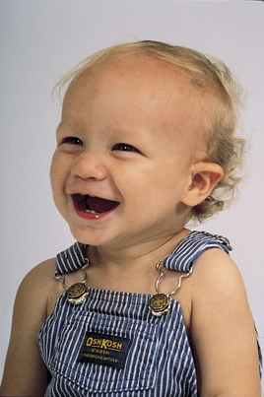
HAPPINESS
Happiness
Feel-good, do-good phenomenon
When we feel happy, we more often help others
Random Acts of Kindness
Well-being
self perceived happiness or satisfaction with life
Notes:
Happiness
People who are happy perceive the world to be safer, feel more confident, make decisions more easily, rate job applicants more favorably, are more cooperative and tolerant, and live healthier more energetic, satisfied lives
Positive emotions fuel upward spirals in your future, your relationships and your hopes
Human faces video with John Cleese—women who smiled happily (rather than a fake smile) in their 1950s yearbook photo were more likely to be married and happy in their middle age
DEMO: Make a list of the top 10 things that make you happy on a piece of paper. Categorize the list into material and non-material items. Create a class list of the individual responses to see which category is larger.
Feel-good,do good phenomenon
When we feel happy, we more often help others (someone drop’s their papers or money on the ground, it feels good to help them out)
Daily “random act of kindness”
Research often has been more focused on negative emotions than positive ones
Can make our lives miserable if we focus on the negatives often seeking therapeutic help
Subjective Well-Being
Assessed as either feelings of happiness (high ratio of positive to negative feelings) or as a sense of satisfaction with life
“Positive Psychology” is on the rise

Slide 30
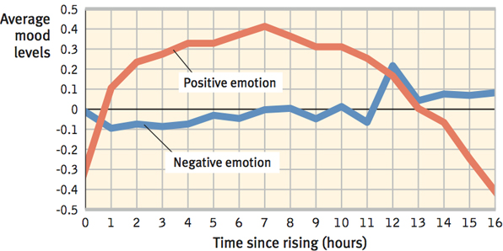
HAPPINESS: THE SHORT LIFE OF EMOTIONAL UPS AND DOWNS
Watson’s studies
**WE OVERESTIMATE THE DURATION OF OUR EMOTIONS AND UNDERESTIMATE OUR CAPACITY TO ADAPT**
Notes:
Short Life of Emotional Ups and Downs
David Watson (2000) and Daniel Kahneman discovered that positive emotion rises over the early to middle part of most days (see chart)
Stressful events (argument, sick child, car problem) trigger bad moods
But, people tend to rebound from bad days to better than usual good days the following day
Emotional ups and downs tend to balance
Even struck by tragedy, paralysis or disease are not permanently depressing
People often think that their lives would be deflated by a breakup in a romantic relationship→After a recovery period, those who do suffer breakups are not noticeably less happy than those who don’t
**We overestimate the duration of our emotions and underestimate our capacity to adapt
Picture on slide: Anna Putt of South Midlands, England suffered a brainstem stroke which left her “locked-in”. After months of therapy, she was able to “talk” by nodding letters, moving an electric wheelchair with her head and to use a computer by nodding while wearing spectacles that guide a cursor.

Slide 31
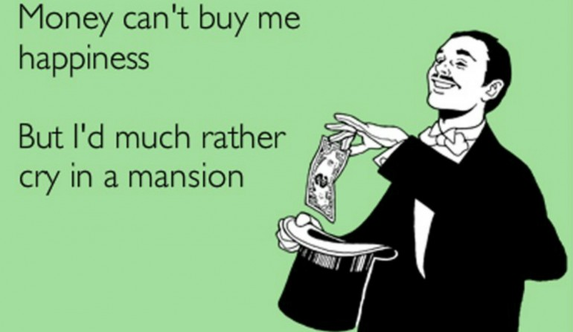
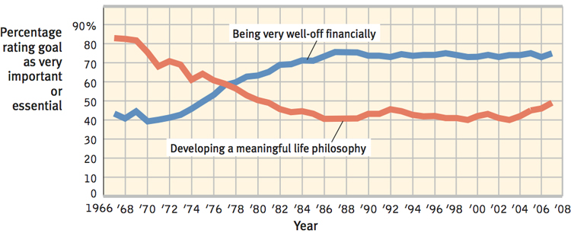
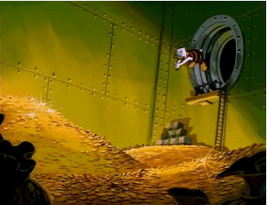
HAPPINESS: WEALTH AND WELL-BEING
Once enough money for comfort and security, continuing to pile up money does not increase happiness even more
DIMINISHING RETURNS/DIMINISHING MARGINAL UTILITY
Notes:
Wealth & Well-Being
Most Americans in a survey would indicate that being “very well off” and being able to support a family are extremely important or essential to happiness
Generally those with lots of money are typically happier than those who struggle to afford life’s basic needs and are less stressed by poverty and lack of control over their lives
Once one has enough money for comfort and security, continuing to pile up money does not increase happiness even more (diminishing returns/diminishing marginal utility)
Robert Cummins (2006) noted that the power of more money increases happiness in lower incomes, but diminishes as income rises
John Cacioppo (2008) notes that today’s happiness predicts tomorrow’s income better than today’s income predicts tomorrow’s happiness

Slide 32
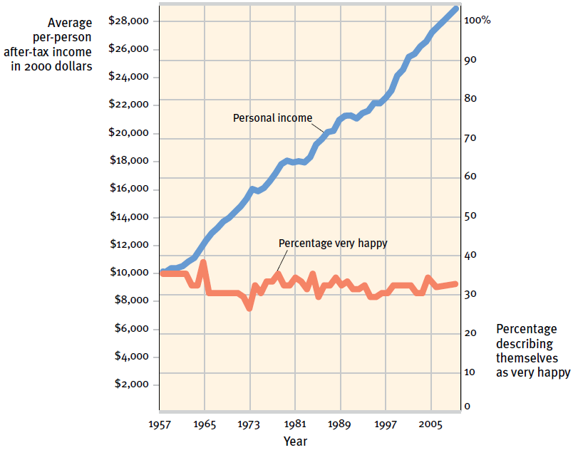
HAPPINESS: WEALTH AND WELL BEING
Notes:
Does money buy happiness?
The average American’s buying power (buying more cars, electronics) has more than tripled in the last 40 years, but their levels of happiness
Those striving hardest for wealth tend to live with lower well-being
Especially try for those seeking money to prove themselves, gain power or show off rather than support their families
Instead, those who strive for “intimacy, personal growth and contribution to the community” experience a higher quality of life and a greater psychological well being
Subjective well-being (happiness + satisfaction) rank Mexico and Puerto Rico at the top of the charts leaving wealthy Western nations towards the bottom
We are paralyzed by having too many things to choose from for everything from grocery items to entertainment choices (spend more time wondering what they will buy and do instead of buying and doing)
People in lower income nations report higher levels of happiness and feel less burdened by regret over not choosing the right thing to do or buy
Politics: Should be more concerned about individuals’ well-being because of its value to its citizens and they will have positive spillover effects for the society as a whole” –see Sean’s article about Happiness
Those who value love over money have a higher satisfaction of life

Slide 33
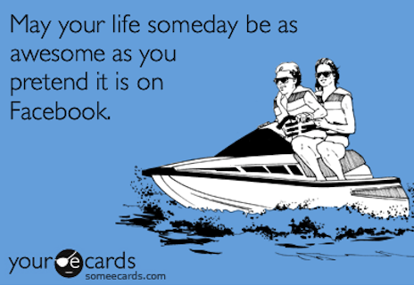
HAPPINESS: TWO PSYCHOLOGICAL PHENOMENA: ADAPTATION AND COMPARISION
Happiness and Prior Experience
Adaptation-level phenomenon
Happiness and others’ attainments
Relative deprivation
https://www.youtube.com/watch?v=XTmt0MG51GU
Notes:
Adaptation & Comparison Phenomena
Happiness and Prior Experience
Adaptation-level phenomenon: our tendency to judge various stimuli relative to those we have previously experienced
Harry Helson explained we adjust our neutral levels—the points at which sounds seem neither loud nor soft, temperatures neither hot nor cold, events neither pleasant nor unpleasant—based on our experiences
We then notice and react to variations up or down from these levels
The neutral level keeps changes as new stimuli is introduced
Happiness & Others’ Attainments
Happiness is relative not only to our past experience, but to our comparisons with others
Whether we feel good or bad depends on who those others are
Concept of relative deprivation—the sense that we are worse off than others whom we compare ourselves
Alex Rodriguez’s 10-year, $275 million baseball contract made him temporarily happy, but likely also diminished other star players’ satisfaction with their lesser multi-million dollar contracts
As people climb the latter of success, they mostly compare themselves with peers who are at or above their current level (creates envy for those above us)
If we compare ourselves to those who are not as well-off, our personal satisfaction and thankfulness in our own lives increases

Slide 34
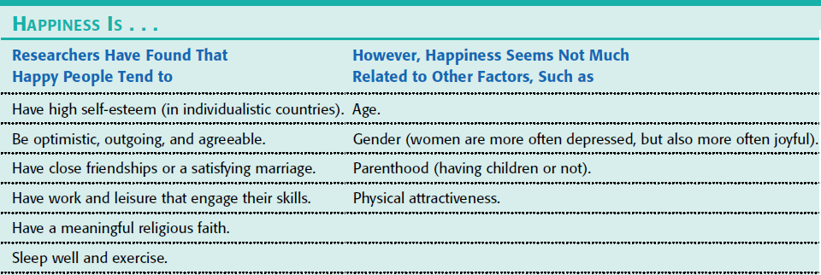
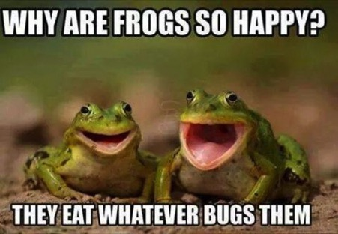
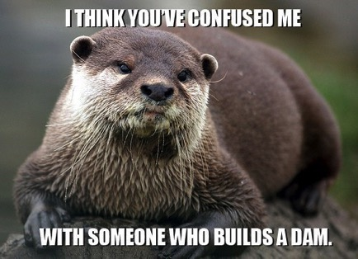
HAPPINESS: PREDICTORS OF HAPPINESS
Notes:
Predictors of Happiness
Some people are normally joyful or gloomy based on their cultural standards
Westerners value self-esteem and social acceptance matters more in collectivist (group) cultures
Across countries, research does reveal several predictors of happiness (see chart)
Tasks and relationships do affect our happiness, so does our genes and the quality of the relationship you have
Genes influence the personality traits which make us happy
People’s happiness set point is not fixed
Satisfaction may rise or fall and happiness can be influenced by factors we cannot control

