Slide 1
EMOTION

Slide 2
Drive Reduction Theory
Arousal Theory
Theories
Maslow’s Hierarchy of Needs
Human Drives
Sources
Measures
Intrinsic/
Extrinsic Motivation
Motivation & Emotion
Motivation
Stress
Explain complex motives (eating, aggression, achievement and sex)
Effects
Coping
We are here
Theories of Emotion
Opponent Process
James-Lange
Cognitive Appraisal
Cannon-Bard
Schachter two-factor

Slide 3
Emotion
Comprised of:
Physiological arousal
Expressive behaviors
Conscious experience
Thoughts
Feelings
Controversies:
Physiological response v. emotional experience?
Thinking v. feeling

Slide 4
COMMONSENSE THEORY OF EMOTION
First comes awareness, then the physiological feeling (when you become happy, your heart starts beating faster)
Notes:
Theories of Emotion
Commonsense view:
First comes awareness, then the physiological feeling (when you become happy, your heart starts beating faster)

Slide 5
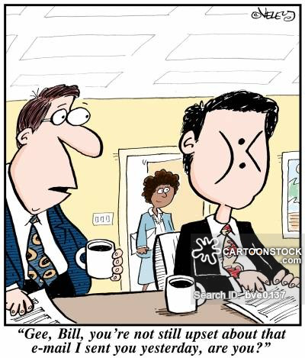
3 Theories of Emotion
James-Lange
Cannon-Bard
Two-Factor theory (Schacter-Singer)

Slide 6
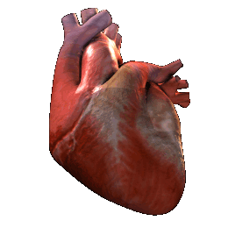
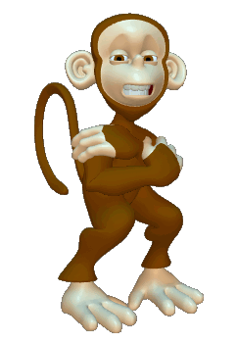
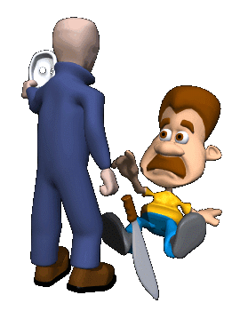
Emotion
Willam James and Carl Lange came up with the James-Lange Theory of Emotion.
We feel emotion because of biological changes caused by stress.
The body changes and our mind recognizes the feeling.

Slide 7
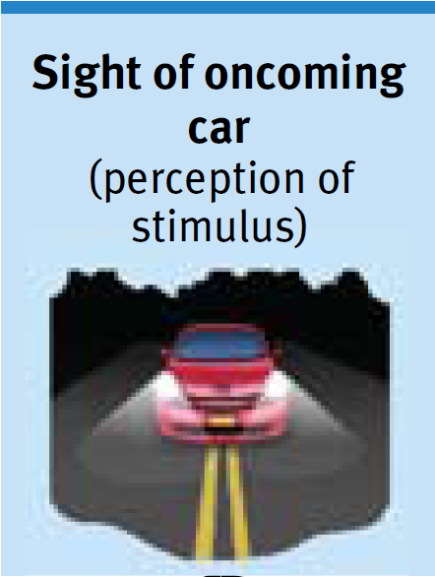
THEORIES OF EMOTION
James-Lange theory
Notes:
William James (psychologist) and Carl Lange’s (physiologist) theory
Commonsense view is backwards
Feeling of fear followed your body’s response to a car skidding on a slippery road
James-Lange theory—first comes a distinct physiological response, then comes our experienced emotion

Slide 8
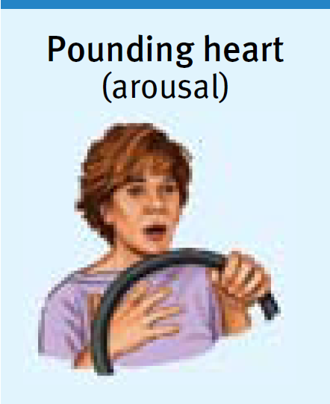
THEORIES OF EMOTION
James-Lange theory
Notes:
William James (psychologist) and Carl Lange’s (physiologist) theory
Commonsense view is backwards
Feeling of fear followed your body’s response to a car skidding on a slippery road
James-Lange theory—first comes a distinct physiological response, then comes our experienced emotion

Slide 9
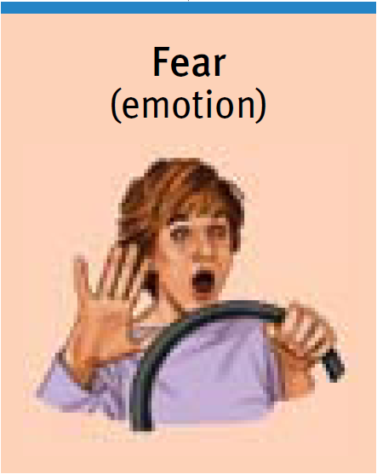
THEORIES OF EMOTION
James-Lange theory
Notes:
William James (psychologist) and Carl Lange’s (physiologist) theory
Commonsense view is backwards
Feeling of fear followed your body’s response to a car skidding on a slippery road
James-Lange theory—first comes a distinct physiological response, then comes our experienced emotion

Slide 10
Cannon-Bard Theory of Emotion
Say James-Lange theory is full of crap.
How can that be true if similar physiological changes correspond with drastically different emotional states.
The physiological change and subjective experience of emotion must occur simultaneously.

Slide 11
THEORIES OF EMOTION
Cannon-Bard theory
Notes:
Walter Cannon (physiologist) and Philip Bard (physiologist)
Cannon thought the body’s responses were not distinct enough to evoke the different emotions
Changes in heart rate, perspiration and body temperature seemed too slow to trigger sudden emotion
Physiological arousal and emotions occur simultaneously
Cannon-Bard theory implies that your heart begins to pound as you experience fear; one does not cause the other

Slide 12
THEORIES OF EMOTION
Cannon-Bard theory
Notes:
Walter Cannon (physiologist) and Philip Bard (physiologist)
Cannon thought the body’s responses were not distinct enough to evoke the different emotions
Changes in heart rate, perspiration and body temperature seemed too slow to trigger sudden emotion
Physiological arousal and emotions occur simultaneously
Cannon-Bard theory implies that your heart begins to pound as you experience fear; one does not cause the other

Slide 13
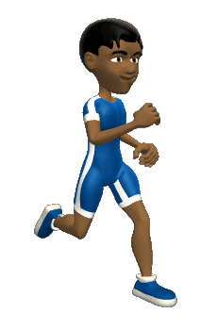
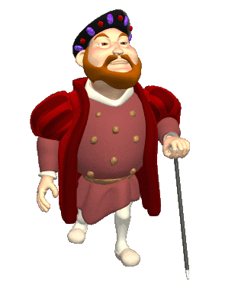
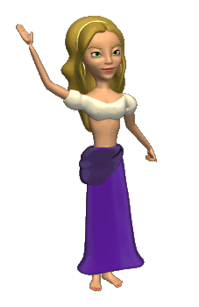
Schachter-Singer Theory of Emotion
To experience emotion one must
Be physically aroused
Cognitively label the arousal
People who are already physiologically aroused experience more intense emotions than unaroused people when both groups are exposed to the same stimuli.
Biology and Cognition interact with each other to increase the experience.

Slide 14
THEORIES OF EMOTION
Two-factor theory
Schachter-Singer
Notes:
Stanley Schacter and Jerome Singer
Our physiology and our cognitions (perceptions, memories and interpretations) together create emotion
Two factor theory—physical arousal + a cognitive label = emotion
Our experience of emotion grows from our awareness of our body’s arousal
Emotions are physiologically similar

Slide 15
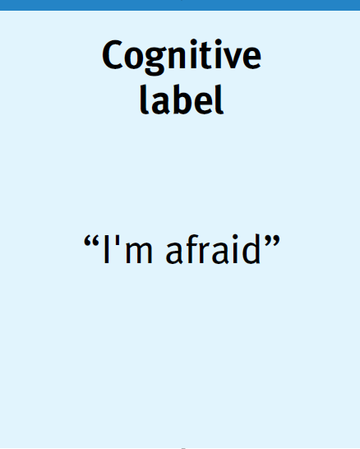
THEORIES OF EMOTION
Two-factor theory
Schachter-Singer
Notes:
Stanley Schacter and Jerome Singer
Our physiology and our cognitions (perceptions, memories and interpretations) together create emotion
Two factor theory—physical arousal + a cognitive label = emotion
Our experience of emotion grows from our awareness of our body’s arousal
Emotions are physiologically similar

Slide 16
THEORIES OF EMOTION
Two-factor theory
Schachter-Singer
Notes:
Stanley Schacter and Jerome Singer
Our physiology and our cognitions (perceptions, memories and interpretations) together create emotion
Two factor theory—physical arousal + a cognitive label = emotion
Our experience of emotion grows from our awareness of our body’s arousal
Emotions are physiologically similar

Slide 17
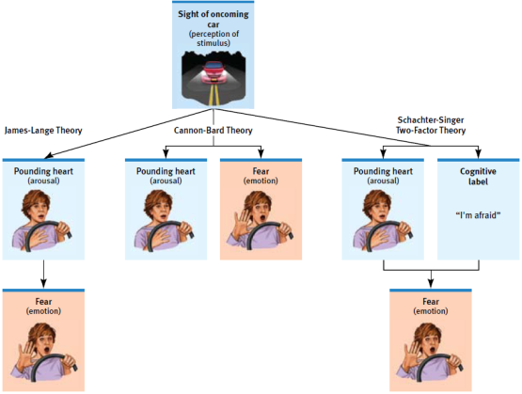
THEORIES OF EMOTION

Slide 18
Components of Emotion

Slide 19
EMOTIONS AND THE AUTONOMIC NERVOUS SYSTEM
Autonomic nervous system
Sympathetic nervous system
arousing
Parasympathetic nervous system
Calming
Moderate arousal is ideal
Notes:
Emotions and the Autonomic Nervous System
Autonomic Nervous System which mobilizes your body for action/crises (sympathetic division) and calms it when the crisis passes (parasympathetic division)
Preparing you to fight or flee
Sympathetic division releases stress hormones epinephrine (adrenaline) and norepinephrine (noradrenaline) → increases extra sugar into your bloodstream, respiration increases, heart rate/breathing increases, digestion slows
If wounded, you would clot easier because more blood is being pumped through your body
Parasympathetic division reverts your bodily functions and calms the body
Arousal in short spurts is adaptive (when taking a test it helps to be a little nervous—but not too much)

Slide 20
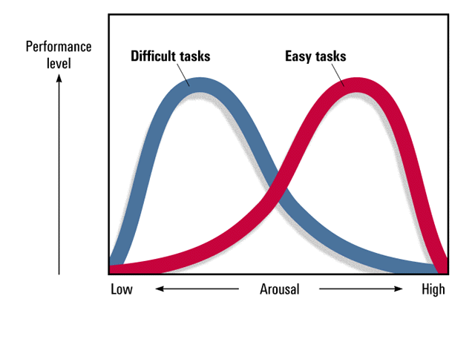
Arousal and Performance
Yerkes-Dodson Law
Performance peaks at lower levels of arousal for difficult tasks, and at higher levels for easy or well-learned tasks
Performance
level
Difficult tasks
Easy tasks
Low
Arousal
High

Slide 21
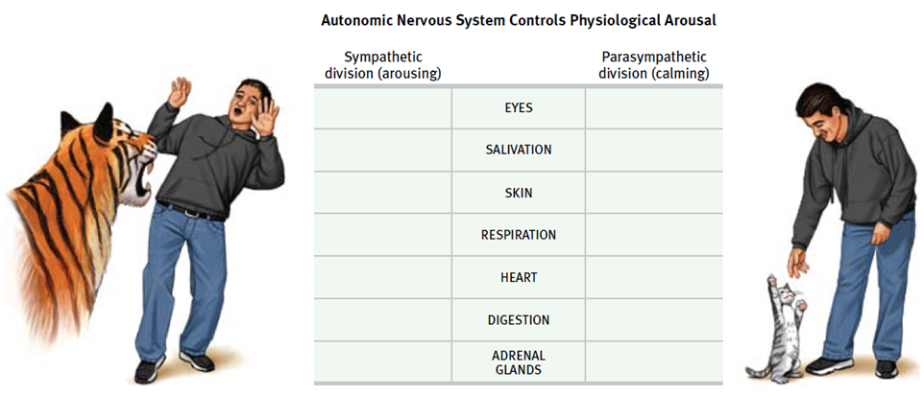
EMOTIONS AND THE AUTONOMIC NERVOUS SYSTEM

Slide 22
EMOTIONS AND THE AUTONOMIC NERVOUS SYSTEM

Slide 23
EMOTIONS AND THE AUTONOMIC NERVOUS SYSTEM

Slide 24
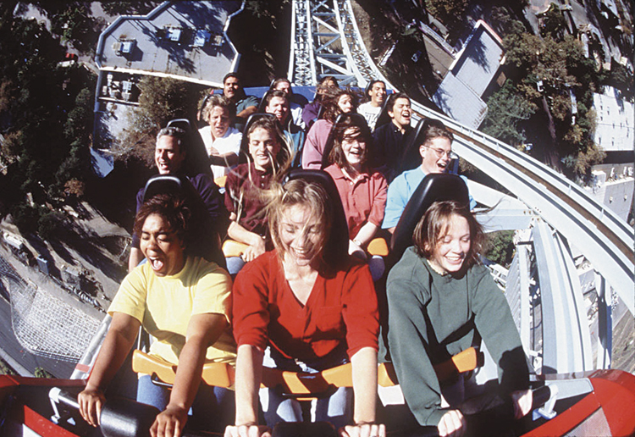
PHYSIOLOGICAL SIMILARITIES AMONG SPECIFIC EMOTIONS
Different movie experiment
Notes:
Physiological Similarities Among Specific Emotions
Physiological differences among fear, anger, love and boredom are similar in the way individuals respond to certain stimuli→ thus have similar physiological arousal, but the emotion has a different look between people

Slide 25
PHYSIOLOGICAL SIMILARITIES AMONG SPECIFIC EMOTIONS
Differences in brain activity
Amygdala - ⬆ activity when watching fearful faces
Frontal lobes
- emotions (right hemisphere)
+ emotions (left hemisphere)
Polygraph
Notes:
Physiological Differences Among Specific Emotions
Finger temperatures and hormone secretions that accompany fear and rage do sometimes differ
Fear and joy stimulate different facial muscles
During fear, brow muscles tense; during joy, muscles in the cheeks and under the eyes pull into a smile
When watching fearful faces, people show more activity in the amygdala (emotional control center in the brain’s limbic system)
Negative emotions tend to be linked to the right hemisphere & positive emotions to the left hemisphere
Generally negative personalities (depression-prone) show more right-frontal lobe activity; positive moods tend to trigger more left frontal lobe activity

Slide 26
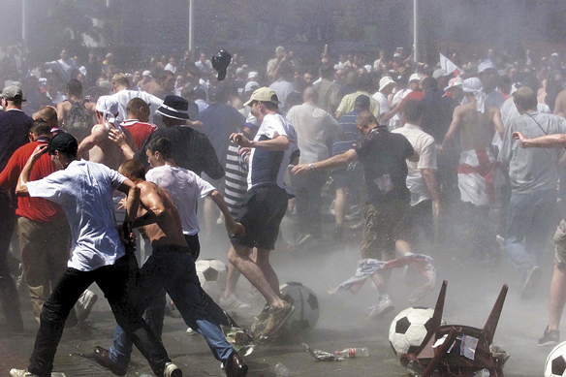
COGNITION AND EMOTION: COGNITION CAN DEFINE EMOTION
Spill over effect
Schachter-Singer experiment
Arousal fuels emotions, cognition channels it
https://www.youtube.com/watch?v=gAMbkJk6gnE
Notes:
Cognition and Emotion
What is the connection between what we think and how we feel?
Can we experience emotion apart from thinking? Or do we become what we think?
Cognition Can Define Emotion
Our arousal response to one event spills over into our response to the next event (spillover effect)
“Catch” the apparent emotion of the person you are with (happy, angry, sad, etc…)
Aroused people react more with hostility in anger-provoking situations
Arousal + label (angry) = emotion—Schachter-Singer’s two factor theory
Arousals fuel emotion, cognition channels it
Cognition Does Not Always Precede Emotion
We have many emotional reactions apart from, or even before, our interpretations of the situation
You’ve hurt someone’s feelings, you have other conversations, but the feelings linger
The arousal lingers, but without a label
A quickly flashed stimulus, such as a smiling or angry face or a disgusting scene, can prime a mood or specific emotion and lead us to feel better or worse about a follow-up stimulus
Flashed a happy face over and over and participants drank about 50% more of a fruit-flavored drink then those who were exposed to an angry face
Some emotions take a “low road” through neural pathways that bypass the cortex (which offers the alternative “high road” pathway
Runs from the eye/ear through the thalamus to the amygdala, bypassing the cortex
This shortcut enables our quick, lightning emotional response before our intellect intervenes (we may be unaware of what has transpired)
When fearful eyes were flashed too briefly for people to consciously perceive them, fMRI scans revealed that their amygdala was alerted. When flashed happy eyes, it did not have this effect.

Slide 27
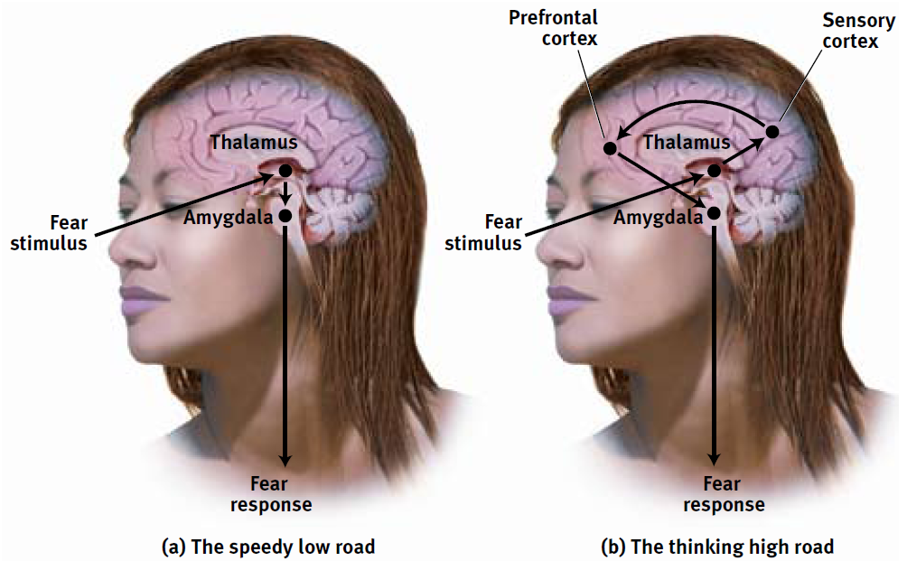
COGNITION AND EMOTION: COGNITION DOES NOT ALWAYS PRECEDE EMOTION
Influence of the amygdala

Slide 28
COGNITION AND EMOTION: COGNITION CAN DEFINE EMOTION
Arousal fuels emotions, cognition channels it
Some emotional response involves no conscious thinking
Conscious appraisal of situation – must decide if beneficial or harmful to our well-being
Emotions greatly influenced by memories, expectations and interpretations
Notes:
Two routes to the emotion
Robert Zajonc and Joseph LeDoux demonstrated that some emotional response (likes, dislikes, fears) involve no conscious thinking
We may fear a spider even if we know it is harmless
Emotion researcher Richard Lazarus noted that some sort of cognitive appraisal of the situation, otherwise how would we know what we are reacting to?
The appraisal may be effortless and we may not be conscious of it, but it is still a mental function
Emotions arise when we appraise an event as beneficial or harmful to our well-being, whether we truly know it is or not (we appraise the sound of rustling in the bushes as the presence of a threat. Later we realize it was just the wind.
Our emotions are greatly influenced by our memories, expectations and interpretations
Some people blow incidents out of proportion
If people think positively it can help them feel better

