Slide 1
ACHIEVEMENT MOTIVATION

Slide 2
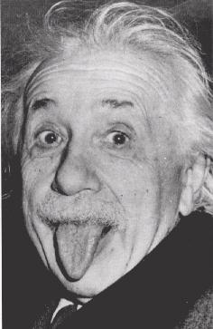
Achievement Motivation
A desire for significant accomplishments; for mastery of things, people, or ideas; for attaining a high standard.

Slide 3
Achievement Motivation
People who have LOW achievement motivation prefer very easy or very difficult tasks.
People with HIGH achievement motivation prefer moderately difficult tasks.
Success is attainable yet attributable to their skill and effort.
Failure is unlikely or not embarrassing

Slide 4
Achievement Motivation
Does high achievement motivation mean success in life?

Slide 5
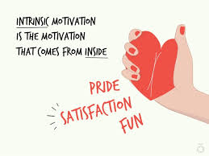
Intrinsic Motivation
A desire to perform a behavior for its own sake.

Slide 6
Extrinsic Motivation
A desire to perform a behavior due to promised rewards or threats of punishment.

Slide 7
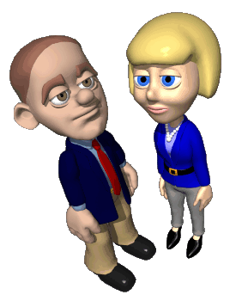
Industrial and Organizational Psychology
Goal Setting Theory
A subfield in psychology that focuses on how to help organizations recruit, select, compensate and train employees.
The object is to utilize the human factor in an organization to increase productivity.

Slide 8
Cultivating Intrinsic Motivation

Slide 9
Leadership Style
Task Leadership: goal oriented leadership that sets standards and organizes work.
Social Leadership: group oriented leadership that builds teamwork, mediates conflict and offers support .

Slide 10
Leadership Perspectives
Theory X
Theory Y

Slide 11
Theory X
Assumes that workers are basically lazy, error-prone, and extrinsically motivated by money.
Must never be trusted and always be watched.
To work more, they must be given money.

Slide 12
Theory Y
Assumes that, given challenge and freedom, workers are motivated to achieve self-esteem and to demonstrate their competence and creativity.

