Slide 1
Stages/REM
Circadian Rhythm
Disorders
Hidden Observer
Actor
Sleep
Dreams
Hypnosis
Meditation
Daydreaming and Fantasy
Altered States of Consciousness
Waking Consciousness
Drug-Altered Consciousness
We are here
Substance Abuse
Stimulants
Depressants
Hallucinogens

Slide 2
Good News!
Psychologists have discovered a treatment that strengthens memory, increases concentration, boots mood, moderates hunger & obesity, fortifies the disease-fighting immune system, and lessens the risk of fatal accidents. Moreover, while supplies last, it’s available free of charge!

Slide 3
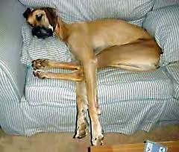
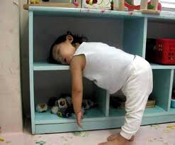
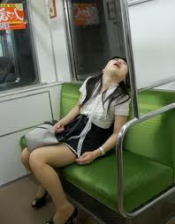
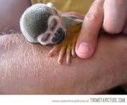
States of Consciousness
Sleep Week!!

Slide 4
States of Consciousness T/F

Slide 5
Consciousness has an unlimited capacity
Most university students are “night owls” whose performance improves throughout the day
People who sleep 7-8 hours a night tend to outlive those who are chronically sleep deprived.
The most common dreams are those with sexual imagery
The majority of the characters in men’s dreams are female
Most psychologists believe that dreams provide a key to understanding our inner conflicts
Under hypnosis, people can be induced to perform feats they would otherwise find impossible/immoral
In large amounts, alcohol is a depressant, in small amounts, it is a stimulant

Slide 6
Consciousness
What is consciousness?
Our awareness of ourselves and our environment
Waking consciousness
Thoughts, feelings, and perceptions that occur when we are awake and alert
Allows us to reflect and plan
Altered States of Consciousness
A mental state that differs noticeably from normal waking consciousness

Slide 7
Forms of Altered-Consciousness
Sleep

Slide 8
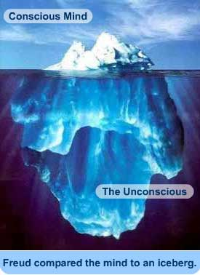
The conscious mind processes information sequentially; it is slow and limited
The unconscious mind processes information simultaneously on multiple tracks

Slide 9
Subconscious processing
Well-learned tasks become automatic
Driving
Typing
When you meet people you unconsciously react to their gender, age and appearance
Bird (color, form, movement, distance)

Slide 10
Consciousness & Information Processing
We are consciously aware of things after our brain processes them
It is slow, but is skilled at solving novel problems

Slide 11
History of Consciousness
Psychology began as a science of consciousness. (Titchner and Structuralism)
Behaviorists argued about alienating consciousness from psychology.
However, after 1960, mental concepts (consciousness) started reentering psychology.
Notes:
OBJECTIVE 1| Discuss the history of psychology’s study of consciousness and contrast conscious and unconscious information processing.

Slide 12
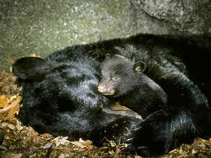
Biological Rhythms/“Clocks”
Include:
Annual Cycles
Geese migrate, bears hibernate, mood changes (SAD)
28-day cycles
Menstrual Cycle
Lunar Cycle

Slide 13
Biological Rhythms/“Clocks”
24-hour cycles (Circadian Rhythm)
Varying alertness (changes with age), body temperature, hormone secretions
Disrupted by jet lag, irregular sleep patterns, light exposure
More on light exposure…
Retinal proteins trigger the suprachiasmatic nucleus—a pair of pinhead sized clusters of 20,000 cells that control the circadian clock
Pineal gland: releases melatonin(sleep hormone)
Adenosine: accumulates the longer we are awake
(Caffeine inhibits)

Slide 14
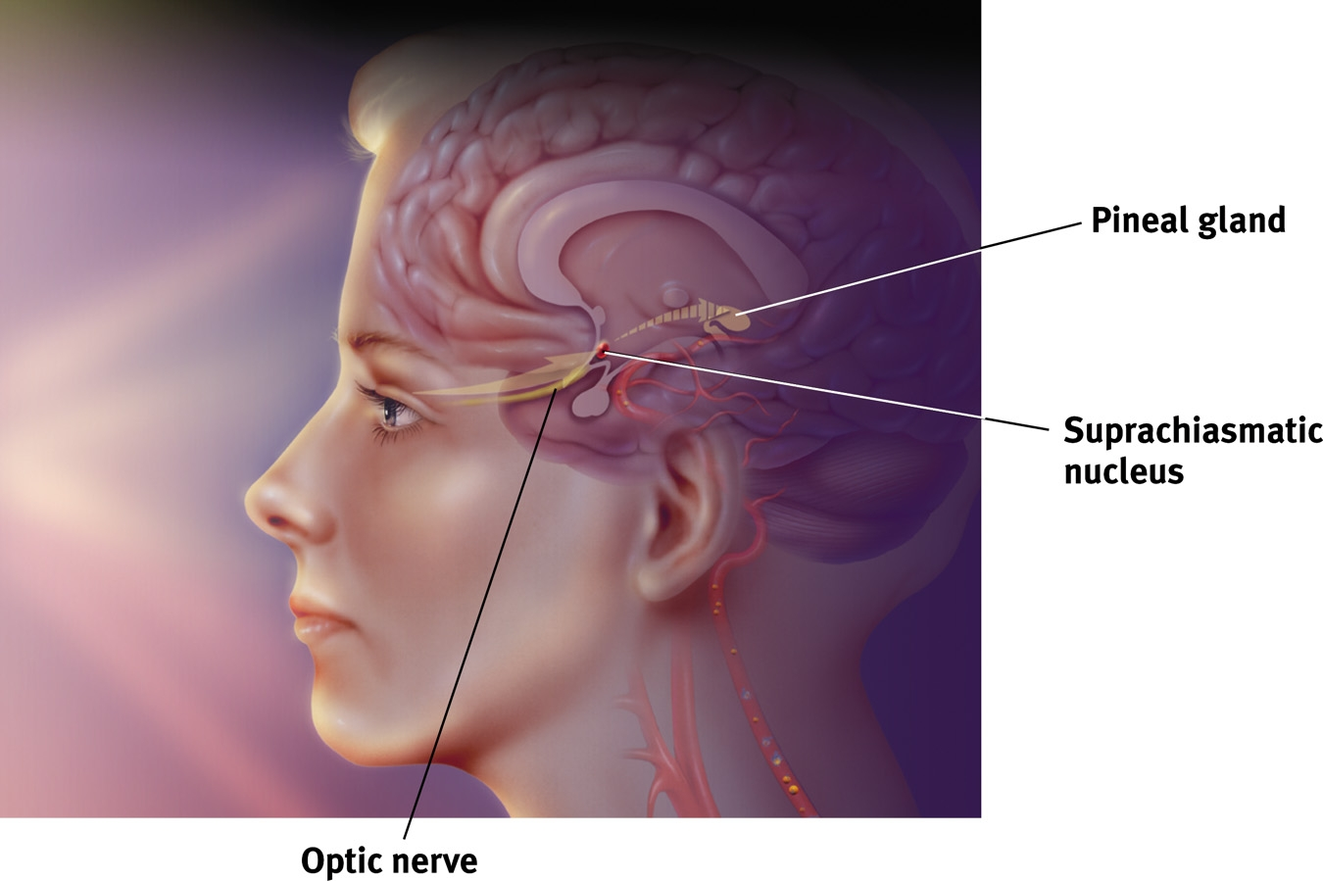

Slide 15
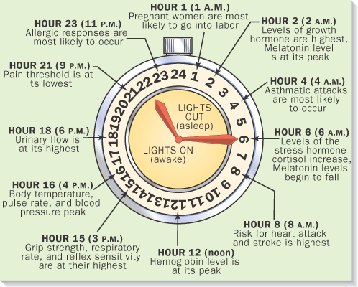
Circadian Rhythms

Slide 16
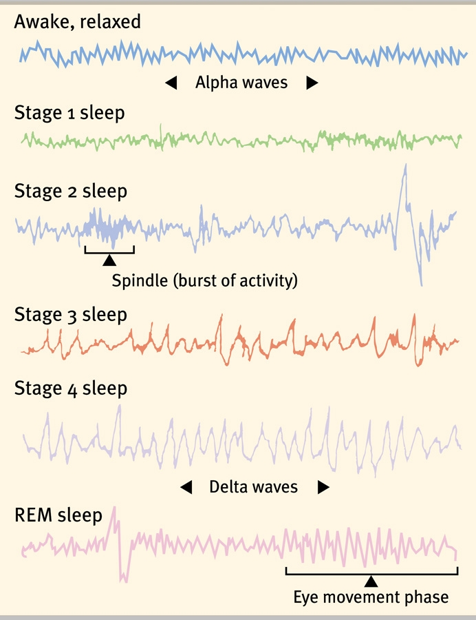
Biological Rhythms/“Clocks”
90-minute cycles
5 Stages of sleep

Slide 17
Stage 1
Brief
Slowed breathing
Irregular brain waves
Images resembling hallucinations
Sensation of falling, something being thrown at you, etc.
Your body jerks or twitches

Slide 18
Stage II
20 minutes long
Sleep spindles (bursts of rapid, rhythmic brain wave activity)
Can still be awakened without too much difficulty
Sleep talking occurs in this stage

Slide 19
Stage III
Lasts for 30 minutes (spend about ½ of the night in stages 2-3)
Begins to emit large delta waves
Difficult to wake

Slide 20
Stage IV
Last for 30 minutes
Large, slow delta waves present
Children may wet the bed
Sleepwalking may occur

Slide 21
Stage V: REM
Rapid Eye Movement
About 10 minutes long
Occurs about an hour after you fall asleep
Ascend through stages 3,2
Rapid brain waves, mimic that of being awake
(Dreaming!)
Heart rate rises
Breathing becomes rapid
Eyes dart around

Slide 22
Stage V: REM
Brain is active, but body is paralyzed
Brainstem blocks neural messages
Must be laying down for REM sleep
Cannot be easily awakened
Paradoxical nature of REM sleep
Over 100,000 dreams in one’s lifetime

Slide 23
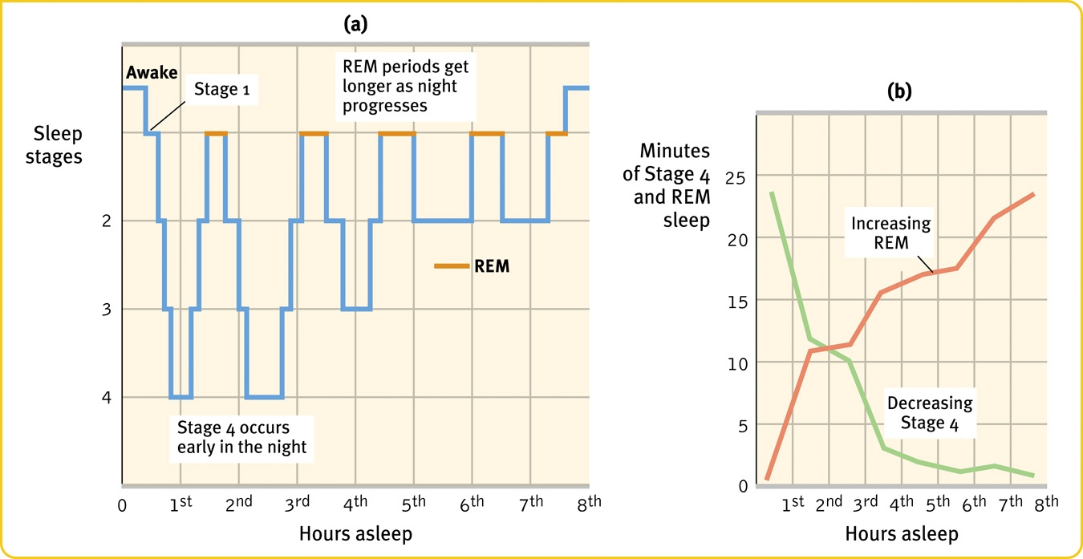
Fun Fact: people don’t snore while they are dreaming!

Slide 24
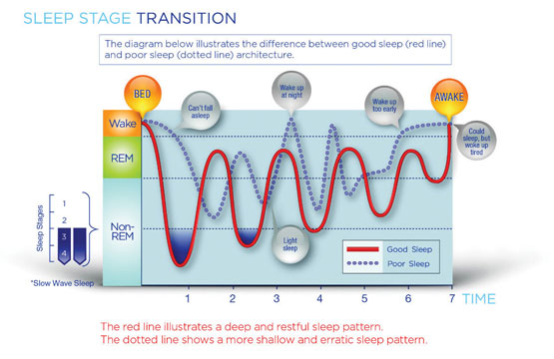

Slide 25
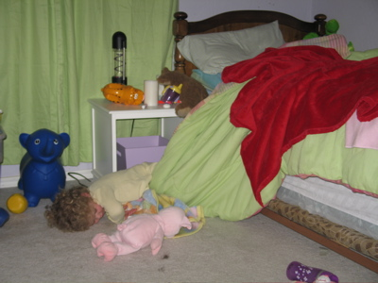
Sleep & Sensation
Why don’t we fall out of bed?
Auditory cortex still functions during sleep
Main point: We process most information outside of our conscious awareness

Slide 26
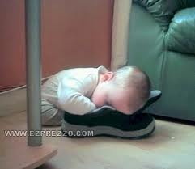
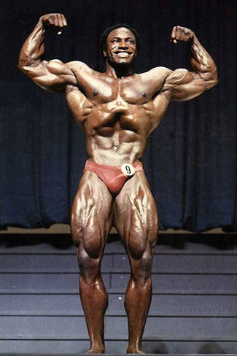
Why Do We Sleep?
4 Theories:
Sleep Protects
Sleep helps us recuperate
Restores and repairs brain tissue
Sleep helps us remember
Rebuilds our fading memories of the day’s experiences
“Just sleep on it”
Sleep plays a role in the growth process
Pituitary gland releases during sleep

Slide 27
Sleep
How much sleep to we need?
Babies sleep 2/3 of their day
Adults: no more than 1/3
Can be genetically influence
Culturally influenced
Most people will sleep 9 hours unhindered
Sleep debt
Brain keeps an account for up to two weeks!

Slide 28
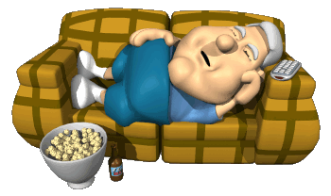
Can you just make up lost sleep in one night?
NO

Slide 29
The Effects of Sleep Deprivation
Tiger Woods said that one of the best things about his choice to leave Stanford for the professional golf circuit was that he could now get enough sleep!
4 in 5 Americans wish they could get more sleep on weekdays
High risk for accidents, difficulty studying, diminished productivity, tendency to make mistakes, irritability, fatigue

Slide 30
Did You Know?
High school and college students are among the most sleep deprived people in our population. 60% are sleepy during the day and 30% fall asleep in class at least once a week
Sleep deprivation costs $150 billion each year in higher stress and reduced worker productivity-(National Commission on Sleep Disorders, 2003.)
Childhood sleeplessness is a high risk factor for adolescent alcohol and drug abuse-children with sleep problems are twice as likely to abuse drugs when teenagers. (Univ. of Mich. April 2004 sleep study.)
30-40% of heavy truck accidents are due to driver fatigue. National Sleep Foundation, 2002 Annual Sleep Survey.

Slide 31
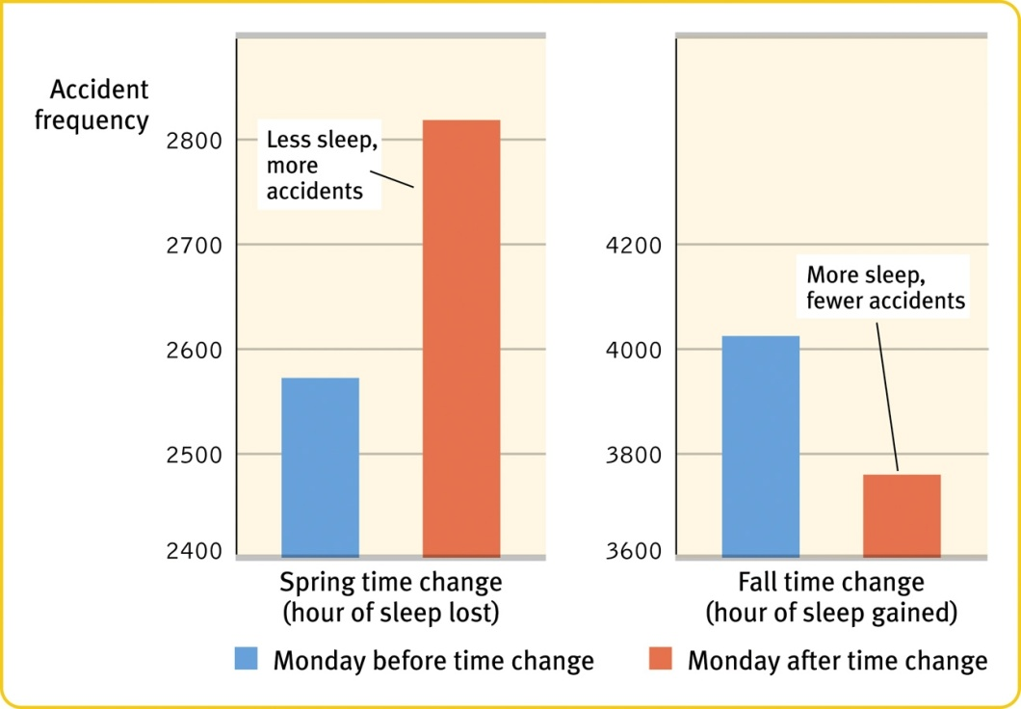
Sleep Deprivation
Exxon Valdez Oil Spill
Chernobyl Nuclear Accident
Suppression of immune system

Slide 32
Stages/REM
Circadian Rhythm
Disorders
Hidden Observer
Actor
Sleep
Dreams
We are here
Hypnosis
Meditation
Daydreaming and Fantasy
Altered States of Consciousness
Waking Consciousness
Drug-Altered Consciousness
Substance Abuse
Stimulants
Depressants
Hallucinogens

Slide 33
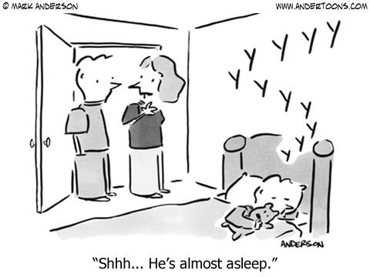
Sleep Disorders
Insomnia
Narcolepsy
Sleep Apnea
Night Terrors
Sleep Walking

Slide 34
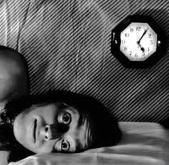
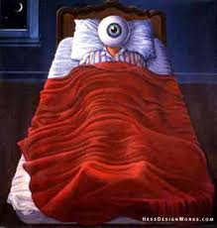
Insomnia
Persistent problems in falling or staying asleep
20% of the population
Sleeping pills & alcohol can aggravate the problem (reduces REM)

Slide 35
Insomnia
Fixes:
Relax before bedtime with a dim light
No caffeine!
Drink a glass of milk
Regular sleep schedule
Exercise—but not in late evening
Hide the clock
***Fatal Familial Insomnia https://www.youtube.com/watch?v=nIeTVVAEFn8

Slide 36
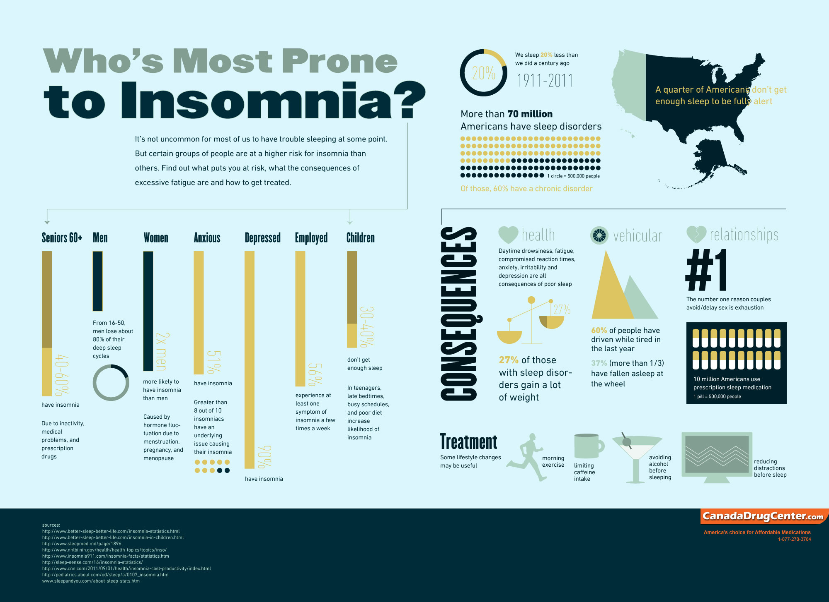

Slide 37
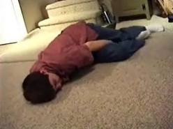
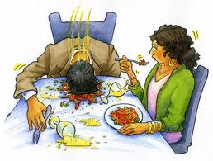
Narcolepsy
Uncontrollable sleep attacks
Directly into REM
Usually lasts less than 5 minutes
1 in 2000 people

Slide 38
Sleep Apnea
“With no breath”
Temporary cessations of breathing during sleep and repeated momentary awakenings.
Unaware
18 million people in US
Treatment: C-PAP mask

Slide 39
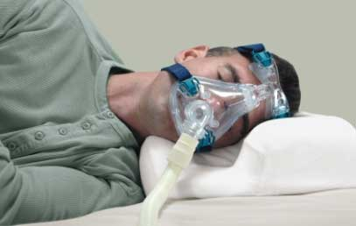

Slide 40
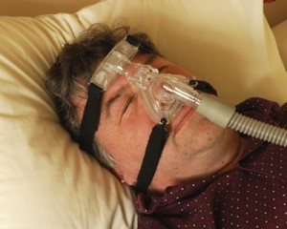

Slide 42
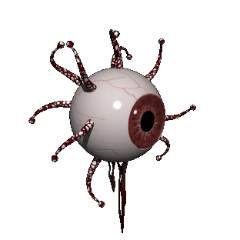
Night Terrors
Targets mostly children
Appear terrified
Remember nothing
NOT nightmares
Occurs in Stage 4

Slide 43
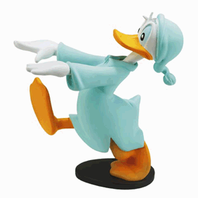
Sleep Walking (Somnambulism)
Stage 4 disorder
Effects an estimated 10 percent of all humans at least once in their lives.
Not recalled the next morning
More common in children
Notes:
REM Behavior Disorder

Slide 44
Stages/REM
Circadian Rhythm
Disorders
Hidden Observer
Actor
Sleep
Dreams
Hypnosis
Meditation
Daydreaming and Fantasy
Altered States of Consciousness
We are here
Waking Consciousness
Drug-Altered Consciousness
Substance Abuse
Stimulants
Depressants
Hallucinogens

Slide 45
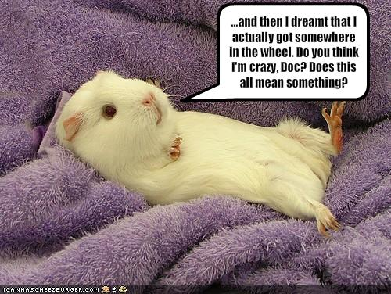
DREAMS
Part FOUR

Slide 46
Dreams
Dreams
Sequence of images, emotions & thoughts that pass through a sleeping person’s mind
Lucid Dreams
Awareness of one’s dreams
Typically happens when the dreamer experiences something strange
Stop to question their reality
Realize they are in a dream

Slide 47
Dreams
Average number of dreams?
4 to 5 times per night
90 minutes apart during REM (sleep cycle)
Range
First dream: 10 minutes
Last dream: 30 minutes

Slide 48
Dreams
Most researchers agree that dreams reflect our waking thoughts, fantasies and emotions
Calvin Hall (dream researcher; 1966)
Dreams reflect everyday & mundane events
Dominated by emotionally significant people
Almost ALWAYS from a first-person perspective
Self-centered; we dream about ourselves
Link between dreams and waking life?
Day Residue (Sigmund Freud)
Culture and dreams?

Slide 49
Dreams
Chased/pursued (81.5)
Rapid falling (76.5)
Sexual experiences (73.8)
Teachers/studying (67.1)
Being late (59.5)
Verge of falling (57.7)
Death (54.1)
Trying again & again to do something (53.5)
Flying/soaring (48.3)
Failing exam (45.0)
Being attacked (42.4)
Frozen with fright (40.7)
Back from the dead (38.4)
Being a child again (36.7)
Being killed (34.5)
Swimming (34.3)
Insects/spiders (33.8)
Being nude (32.6)
Being inappropriately dressed (32.5)

Slide 50
Dream Theories
https://www.youtube.com/watch?v=2W85Dwxx218&t=18s

Slide 51
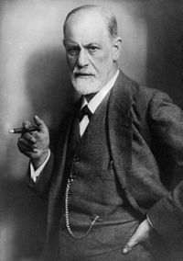
Theory: Wish-Fulfillment
Sigmund Freud
The Interpretation of Dreams (1900)
An expression of unconscious desires & internal conflicts; provide a safety valve by which to dispose of unacceptable feelings
Unconscious may try to censor & disguise true meaning of dreams
Manifest Content v. Latent Content
What is required to decipher the latent content of one’s dreams?

Slide 52
Theory: Cognitive Problem-Solving
Rosalind Cartwright
Dreams provide an opportunity to work through everyday problems & emotional issues; continuity between waking & sleeping thought
Allows for creative thinking with regards to pressing personal issues because dreams are not restrained by logic or realism

Slide 53
Theory: Activation-Synthesis
J. Allan Hobson (and McCarley)
Dreams are the side effects of the neural activation that produces beta brain waves during REM sleep
Neurons that fire periodically in the pons inhibit voluntary movement & send random signals to the cortex
The cortex synthesizes/constructs a dream from memories and other stored information in order to make sense of these signals
The frontal lobes are more-or-less shut down during dreaming; significance?

Slide 54
Other Dream Theories
Information Processing
Dreams may help sift, sort and fix a day’s experiences in our memories
Physiological Function
Dreams provide the sleeping brain with periodic stimulation to develop and preserve neural pathways

